Slide 1
Procurement Management

Slide 2
Procurement Management
Importance
Make or buy decision
Types of contracts
Procurement cycle

Slide 3
Procurement Management
The acquisition of products or services not produced or delivered by the project team
May require the assistance of experts
Your project may be on the other side also—providing services to another organization
Legal implications of signing a contract
The make or buy decision
Expertise
Resource availability
Licensing, regulatory requirements

Slide 4
Procurement Management
Fixed Price
Cost reimbursable
Time and materials

Slide 5
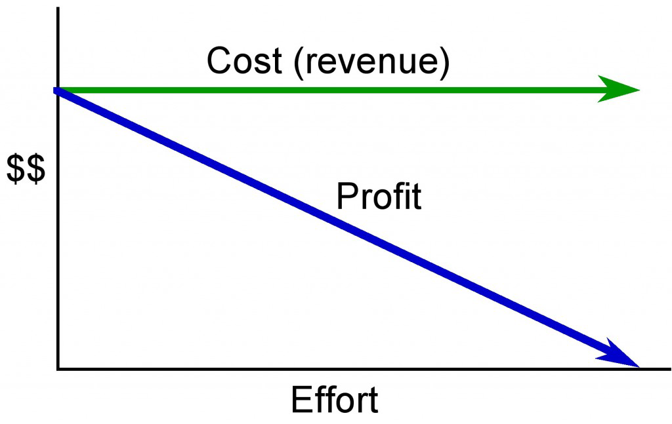
Fixed Price Contract
Figure 17.6.1: A fixed price contract the cost constant regardless of effort applied or delivery date.
Illustration from Barron & Barron Project Management for Scientists and Engineers, http://cnx.org/content/col11120/

Slide 6
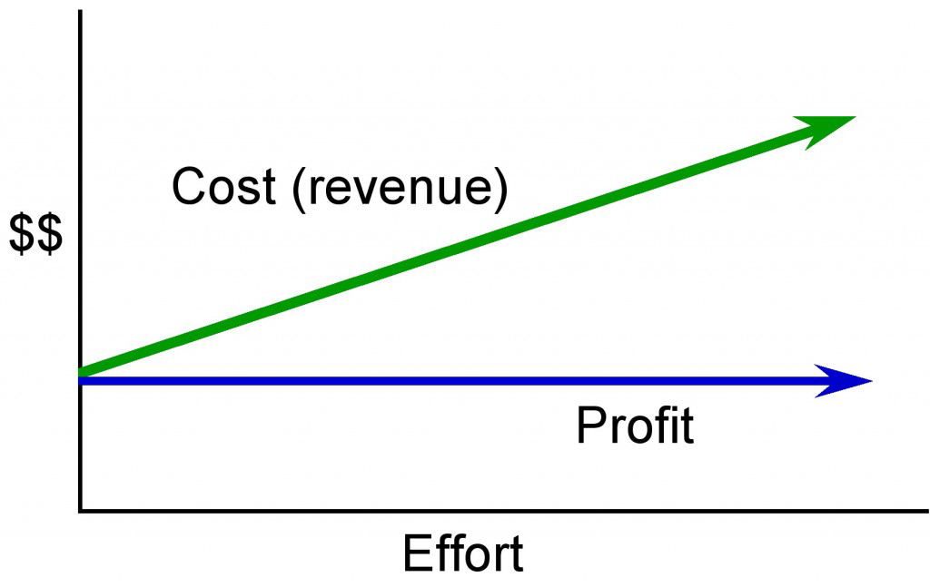
Cost Reimbursable Contract
Figure 17.6.2: In a cost reimbursable or cost plus contract, the seller is guaranteed a fee.
Illustration from Barron & Barron Project Management for Scientists and Engineers, http://cnx.org/content/col11120/

Slide 7
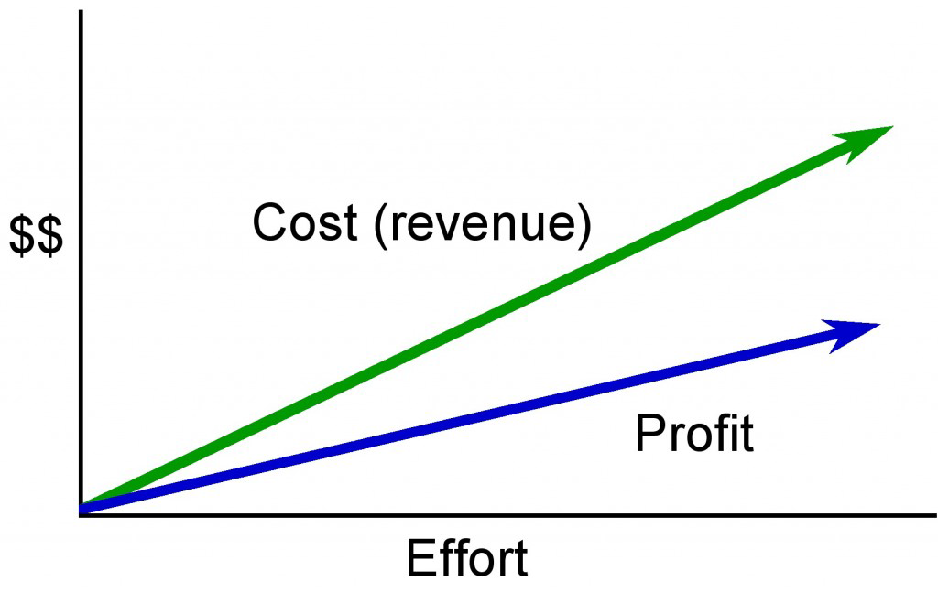
Time and Materials
Figure 17.6.3: In a time and materials contract the cost (or revenue to the vendor) increases with increased effort.
Illustration from Barron & Barron Project Management for Scientists and Engineers, http://cnx.org/content/col11120/

Slide 8
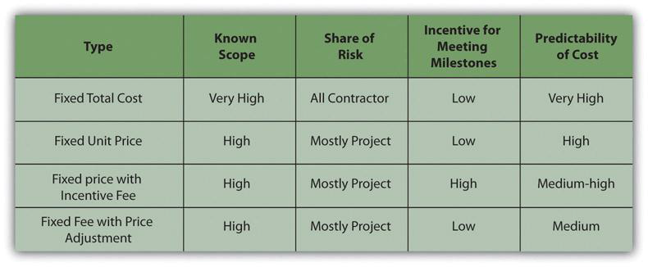
Fixed Price Contract types
Figure 17.6.1.1 Table of Fixed Price Contracts and Characteristics
Source: http://pm4id.org/9/5/

Slide 9
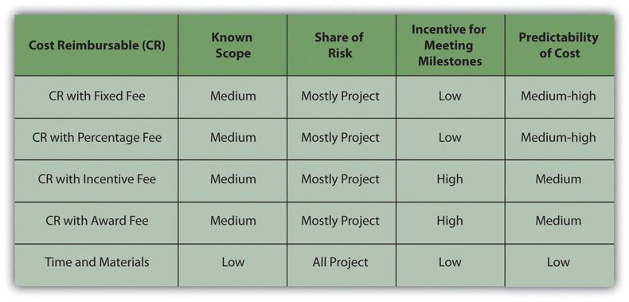
Cost-Reimbursable Contract Types
Figure 17.6.2.1 Table of Contract Types and Characteristics
Source: http://pm4id.org/9/5/

Slide 10
Procurement Cycle
Procurement Plan
Selecting the Contract Approach
Skill level, uniqueness
Type of relationship: supplier, vendor, partnership
RFP, RFQ, personal contact
How well known is the scope of the work?
Risks—what are they? Who assumes them?
How much float if any?
How important to be sure of cost in advance?
Soliciting bids

Slide 11
Procurement Cycle - continued
Qualifying bidders
Request for Quote (RFQ)
Request for Proposal (RFP)
Evaluating the bids
Usually a matrix approach
Cost is NOT the only consideration
Awarding the contract
Managing the contracts
Logistics and expediting
Change coordination

Slide 12
Procurement Management Summary
Make or buy analysis
Contract types
Fixed Price
Cost reimbursable
Time and materials
The Procurement Cycle
Bidder qualification
RFP or RFQ
Analysis and selection
Contract negotiation
Contract administration
Contract closure

Slide 13
Chapter Summary
Procurement is an important activity for project managers
Procurement management includes deciding about contracts and relationships with vendors, suppliers, partners
All stages of procurement should be closely monitored
Reporting to the team and to management are important components in budget and procurement management

Slide 14
Questions?

