Slide 1
Exploring substance use in Canada; A curriculum for Social Service Workers
Chapter 1: Language and Substance Use

Slide 2
Learning Objectives
Recognize the role of the social determinants of health on individuals.
Define intersectionality.
Describe stigma.
Recognize appropriate and inappropriate language regarding substance use.
Explain how language contributes to stigma.
Explain how stigma can impact a person’s health.
Illustrate the role of compassion for others and self.

Slide 3
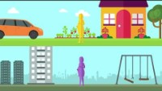
What are the social determinants of health?
https://www.youtube.com/watch?v=plDaS8_LoYo
(Public Health Agency of Canada, 2019).

Slide 4
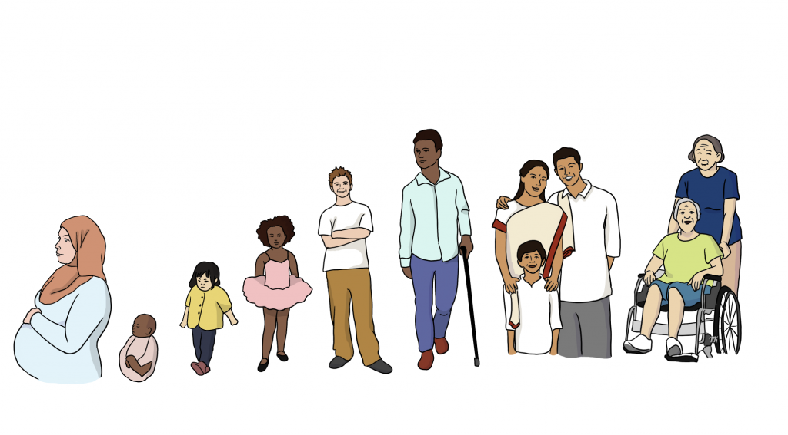
The social determinants of health
“are the broad range of personal, social, economic and environmental factors that determine individual and population health” (Government of Canada, 2020).
This Photo by Unknown Author is licensed under CC BY-SA

Slide 5
The social determinants of health include:
Income and social status
Employment and working conditions
Education and literacy
Childhood experiences
Physical environments
Social supports and coping skills
Healthy behaviors
Access to health services
Biology and genetic endowment
Gender
Culture
Race / Racism
(Government of Canada, 2020).

Slide 6
There are intersectionalities between the social determinants of health
This means looking at the connections between the social determinants of health and how people experience the world differently.
For example, examining gender and race together, rather than keeping each separate will help us provide a more comprehensive service to the people we work with.

Slide 7
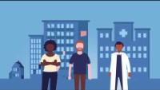
A closer look at Intersectionality
https://www.youtube.com/watch?v=rwqnC1fy_zc
(Sociologial Studies Sheffield, 2020).

Slide 8
Intersecting “isms” can create inequalities if we do not view them through a lens of intersectionality.
Racism is the act of discriminating against someone based on their race/ ethnicity.
Sexism is the act of discrimination against someone based on their sex or gender
Ageism is the act of discrimination against someone based on their age
Classism is the act of discrimination against someone based on their social class
Disablism is the act of discrimination against someone based on their physical or psychological differences

Slide 9
The History of the word “addiction”
The term has evolved and only came to use in the 17th century relating to substance use, with the medical conception of addiction beginning around the 19th century (Levine, 1978).
The word Addiction is rooted in Latin and was used in the early Roman Republic as “being bound to” or “enslaved by” (Levine, 1978). It meant a person was bound to a creditor (as in a person owed something).

Slide 10
Changing The Language of “Addiction”
Instead of:
We could say:
Addiction
Substance Abuse
Clean (That person is “clean” from drugs)
Drug Addict
Alcoholic

Slide 11
Why is our vocabulary surrounding substance use important?
(Canadian Centre on Substance Use and Addiction, 2017).

Slide 12
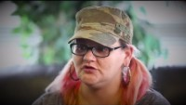
How does stigma impact individuals living with substance use disorder?
https://www.youtube.com/watch?v=NtxaFXThrzA
(Northern Health BC, 2017).

Slide 13
How does stigma affect the health of a person living with a substance use disorder?
Stigma can prevent individuals from accessing support due to self-stigmatization (lack of self-worth, low self-esteem).
Previous poor experiences with healthcare or other services can also prevent a person from reaching out for support.

Slide 14
Where do we begin when it comes to reducing the stigma surrounding substance use disorders (SUD)?
https://www.youtube.com/watch?v=23KMfX5R8lM
(Canadian Centre on Substance Use and Addiction, 2019).

Slide 15
After watching this short film, make a list of what Social Service Workers can do to reduce stigma.

Slide 16
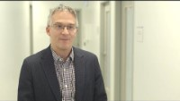
How we can we seek to eliminate the stigma and discrimination surrounding substance use and substance use disorders?
https://www.youtube.com/watch?v=FowNgyoAhpc
(Canadian Centre on Substance Use and Addiction, 2017).

Slide 17
Racism, stigma and substance use:
The impacts of slavery, which existed in Canada (Cooper, 2006), and colonization of People of Color has been and is both overt, subtle, and systemic (Government of Canada, 2020).
Indigenous people have also been impacted by racism and stigma through colonization. This racism extends through the language we use when it comes to substance use.

Slide 18
Language matters
Addressing the language we use is an important part of addressing racism, reducing stigma, and supporting the health of minorities in Canada.
For example, the intersectionality of black people's lives in Canada includes "age, gender, sexual orientation, ability, religion, immigration status, country of origin, socioeconomic status, and racialized identity" (Government of Canada, 2020, para. 6).
For Indigenous Canadians intersectionality also exists between colonialism, residential schools, and trauma. "While the experiences of First Nations, Métis and Inuit in Canada are unique, they have all endured and pushed back against hundreds of years of colonization, persecution and on-going structural violence that was intended to push them to the margins of society” (Interagency Coalition on AIDS & Development, 2019, p. 4).

Slide 19
Decolonizing Substance Use & Addiction:
https://www.youtube.com/watch?v=j95ayhyadNE
(TedxSFU, 2020).

Slide 20
How Can We Make a Difference?
Actively talk about racism and how it exists in our lives.
Address the language we use
Address the language others use around us
Support the health of minorities
We can provide trauma and culturally sensitive programming to people who have a racialized identity
Being aware of the correlation, and ensuring we use a people first language while supporting an individual who has experienced these things.
Seek out training that can support your understanding of language, racism, and stigma.
Reflect on our identity and begin to examine privilege, “an invisible package of unearned assets” (McIntosh, 1998). http://also-chicago.org/also_site/wp-content/uploads/2017/03/white-privilege.pdf
Learn more about traditional or cultural ways.

Slide 21
The Intersectionality of Sex, Gender and Substance Use
A person’s biological sex (male or female), and how they identify (gender), plays a role in their substance use and development of substance use disorders.
Researchers suggest there are “environmental, sociocultural and developmental influences” (Becker et al., 2017, para. 1) when it comes to sex, gender and substance use. “Women living with a history of substance use and addiction encounter many barriers when trying to access forums that are directly related to their life issues” (Paivinen & Bade, 2008, p. 215).
Women as a gendered group face greater stigmatization than men for using drugs since they go against the character traits of perceived female identity. Feeling unsupported and judged” (Eggertson, 2013, p. 1562) can negatively impact their mental health and may prevent them from further accessing health care.
The stigma of substance use is also greater for mothers since they are expected to be the caregivers, raise children, and be more family oriented than fathers. (Lee & Boeri, 2017, para. 18).
Race and gender, as intersections of identity, also play a role in substance use and the development of a substance use disorder.

Slide 22
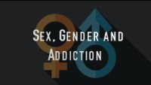
https://www.youtube.com/watch?v=nP--FR198Cc
(National Institute on Drug Abuse, 2019).

Slide 23
Sex Differences in Stages of Addiction
 | Acquisition | Escalation | Maintenance | Withdrawal | Relapse
Women | Initial exposure to drug, food or activity. May experience more pleasurable responses to drugs than men (cocaine, amphetamine). More likely to self- medicate than men. | Increase in amount and frequency of drug taking. For those at risk for addiction, escalation is more rapid than for men (gambling, alcohol, drugs). | The addictive behavior is established and stabilizes. Females stabilize at higher doses of drug than do males. Side effects of drug use are greater for women. | Female smokers report increased negative affect during withdrawal and experience a greater stress response than men do. | Women are more likely to relapse than men and do so more sporadically.
Men | Initial exposure to drug, food or activity. Take drugs and engage in risky behaviors to be part of the group more than women do. | Slower escalation than for women (gambling, alcohol, drugs). | The addictive behavior is established and stabilizes. Males stabilize at lower doses of drug than do females. | Men exhibit greater symptoms of withdrawal from alcohol than women. | Men have longer periods of abstinence than women.
https://www.ncbi.nlm.nih.gov/pmc/articles/PMC5120656/table/T1/?report=objectonly

Slide 24
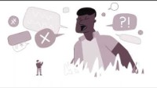
Your role as a Social Service worker is not to diagnose or treat but to provide support and appropriate referrals.
The Language of Compassion
https://www.youtube.com/watch?v=RD0EOwWK8gI
(Canadian Centre on Substance Use and Addiction, 2021).

Slide 25
Self Care
Please complete the self care module and report back next class.
This Photo by Unknown Author is licensed under CC BY-NC-ND

Slide 26
References
Accurate Creative. (2019, May 28). Public Health Agency of Canada- Social Determinants of Health. [Video]. Youtube. https://www.youtube.com/watch?v=rwqnC1fy_zc
Canadian Centre on Substance Use and Addiction. (2017). Changing the language of addiction, fact sheet. https://www.ccsa.ca/changing-language-addiction-fact-sheet
Canadian Centre on Substance Use & Addiction. (2020). Managing stress anxiety and stress during Covid-19. https://www.ccsa.ca/sites/default/files/2020-04/CCSA-COVID-19-Stress-Anxiety-and-Substance-Use-Health-Care-Providers-Infographic-2020-en.pdf
Canadian Centre on Substance Use & Addiction. (2021). My journey begins with compassion. [Video]. Youtube. https://www.youtube.com/watch?v=RD0EOwWK8gI
Canadian Centre on Substance Use and Addiction. (2018). Stigma and Discrimination in the Language of Addiction, Dr. Kenneth Tupper. [Video]. YouTube. https://www.youtube.com/watch?v=FowNgyoAhpc
Canadian Centre on Substance Use and Addiction. (2019). Illuminate. [Video]. YouTube. https://www.youtube.com/watch?v=23KMfX5R8lM
Cooper, A. (2006). The hanging of Angélique: The untold story of slavery in Canada and the burning of Old Montréal. University of Georgia Press.
First Nations Health Authority. (2015). Decolonizing substance use. https://uphns-hub.ca/wp-content/uploads/2021/05/PowerPoint-Decolonize-Substance-Use-Indigenous-Harm-Reduction.pdf
Government of Canada. (2020a). Social determinants of health and health inequities. https://www.canada.ca/en/public-health/services/health-promotion/population-health/what-determines-health.html
Government of Canada (2020b). Social determinants and inequities in health for Black Canadians: A snapshot. https://www.canada.ca/en/public-health/services/health-promotion/population-health/what-determines-health/social-determinants-inequities-black-canadians-snapshot.html
Interagency Coalition on AIDS & Development. (2019). Indigenous harm reduction, reducing the harms of colonialism, policy brief. https://www.canada.ca/en/public-health/services/health-promotion/population- health/what-determines-health/social-determinants-inequities-black-canadians-snapshot.html

Slide 27
References Continued
Lee, B., Kellett, P., Seghal, K., & Van den Berg, C. (2018). Breaking the silence of racism injuries: A community-driven study. International Journal of Migration, Health, and Social Care, 14(1), 1-14. http://dx.doi.org/10.1108/IJMHSC-01-2016-0003
Lee, N., & Boeri, M. (2017). Managing stigma: Women drug users and recovery services. Fusio: the Bentley Undergraduate Research Journal, 1(2), 65–94. https://www.ncbi.nlm.nih.gov/pmc/articles/PMC6103317/
McIntosh, P. (1989). White privilege: Unpacking the invisible backpack. Peace and Freedom Magazine. https://psychology.umbc.edu/files/2016/10/White-Privilege_McIntosh-1989.pdf
National Institute on Drug Abuse. (2019). Sex, gender and addiction. [Video]. Youtube. https://www.youtube.com/watch?v=nP–FR198Cc
North End Community Health Centre. (2021). 50 Years of NECHC. [Video]. Youtube. https://www.youtube.com/watch?time_continue=20&v=yN1GQ7_dkXo&feature=emb_logo
Northern Health B. C. (2017, March 29). Stop stigma. Save lives: Experiences of stigma. [Video]. YouTube. https://www.youtube.com/watch?v=NtxaFXThrzA
Paivinen, H., & Bade, S. (2008). Voice: Challenging the stigma of addiction -a nursing perspective. International Journal of Drug Policy, 19(3), 214-219 https://doi.org/10.1016/j.drugpo.2008.02.011
Royal College of Physicians and Surgeons of Canada. (2015, March 25). Bridging the gap between traditional and western medicine: The remarkable work of Dr. Karen Hill. [Video]. YouTube. https://youtu.be/nVQU1EmoWoU
Sociological Studies Sheffield. (2020, Oct. 8). Intersectionality and health explained. [Video]. Youtube. https://www.youtube.com/watch?v=rwqnC1fy_zc
Varin, M., Palladino, E., Hill MacEachern, K., Belzak, L. & Baker, M. M. (2021). At a glance: Prevalance of alcohol use among women of reproductive age in Canada. Health Promotion and Chronic Disease Prevention in Canada Journal, 41(9), 267-272. https://doi.org/10.24095/hpcdp.41.9.04

