Slide 1
Exploring Substance Use in Canada. A Curriculum for Social Service Workers
Chapter 5: Process Addiction

Slide 2
Learning Objectives:
Discuss the various types of process or behavioural addictions
Identify process or behavioural addictions and the impact on individuals and communities

Slide 3
We participate in any number of activities and behaviors depending on a multitude of factors including:
Exposure to activities
Our upbringing
Socio-economic status
Dddddddddddddddddddd
This Photo by Unknown Author is licensed under CC BY

Slide 4
Coping skills
Most people have activities they enjoy doing, and activities that help them cope with life’s daily stressors, more significant stresses or even traumatic experiences.
Coping skills are important, and as Social Service workers, having a set of effective coping skills for managing stress is important. You can help your clients discover coping skills that are healthy.
This Photo by Unknown Author is licensed under CC BY-NC-ND

Slide 5
Features of a Substance Use Disorder
The term substance use disorder describes a person’s use of substances and incorporates several features:
-Repetitive engagement in behaviours that are rewarding
-Loss of control
-Persistent use despite negative consequences
-Physical dependence, evidenced by withdrawal (Chamberlain et al., 2015).
If this is the criteria for a substance use disorder, is it possible for a behaviour to fall in this category?
When does an activity become an addiction or disorder?

Slide 6
What Is a Process Addiction
https://youtu.be/oZjZcSOGj6o
(Sunrise Residential Treatment Centre, 2015).

Slide 7
A Behaviour Can Be a Disorder:
“Behavioural addictions result in a failure to resist an impulse, drive, or temptation to perform an act that is harmful to the person or to others” (Grant et al., 2013, p. 252).
Grant et al., (2013) suggest that “behavioural addictions include:
Pathological gambling
Kleptomania
Pyromania
Compulsive buying
Compulsive sexual behaviour
Internet addiction
Binge eating disorder” (p. 252)
According to the DSM-V, only one behaviour is currently considered a disorder: gambling.

Slide 8
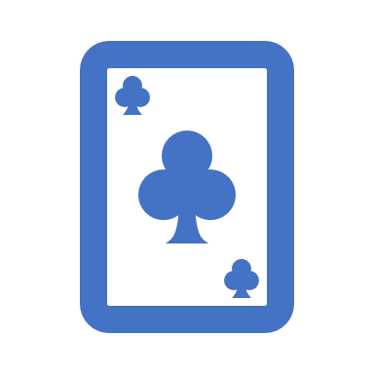
Process Addiction: Gambling and the DSM-V
At this time there does not seem to be a consensus among researchers on process/behavioural addiction related to the DSM-V.
Gambling in section 5.2, as identified/quantified in the DSM -5 as a disorder:
-“Of existing disorders, only gambling had enough in common with substance use disorders to justify its inclusion” (Grant & Chamberlain, 2016, p. 300). We will also examine other disorders as suggested by Grant et al (2013).

Slide 9
Behaviors as Addictions and WHO
The World Health Organization would suggest other behaviours be considered as they have “held annual meetings since 2014 to discuss pressing needs, research agendas and policy initiatives related to Internet use, with gaming disorder being proposed as a formal diagnosis” (Potenza et al., 2018, p. 30).

Slide 10
How are process addiction and substance use disorders similar?
“Some conditions, such as gambling disorder, compulsive stealing, compulsive buying, and compulsive sexual behavior, and problem internet use, have phenomenological and neurobiological parallels with substance use disorders” (Grant & Chamberlain, 2016, p. 301).
For clients who have compulsive sexual behaviours and substance use disorders, brain activity is mirrored in the areas of the ventral striatum, dorsal anterior cingulate and amygdala (Voon et al., 2014).
If you examine these parts of the brain, the ventral striatum focuses on reward and motivation; the dorsal anterior cingulate anticipates rewards and cravings (Voon et al., 2004).
If the behaviour triggers the brain, it may not be as quick or intense as a substance, but there is still an impact on the reward areas of the brain.

Slide 11
Gambling
Is placing a bet (monetary, time, services or other) with the possibility of a desired result (monetary, services, time or other) (CPRG, 2015).
76% to 79% of adult Canadians participate in some form of gambling in a year (Kingston, Frontenac, Lennox, and Addington Public Health 2021).

Slide 12
Gambling on Addiction
https://youtu.be/m3aDOTSqh94
(The Fifth Estate, 2018).

Slide 13
Gambling Disorders
According to Grant and Chamberlain (2016), Many people with gambling disorder report an urge or craving state prior to gambling, as do individuals with substance addictions; gambling often decreases anxiety and results in a positive mood state or “high,” like substance intoxication; and emotional dysregulation often contributes to gambling cravings just as with alcohol or drug cravings. (p. 301)
This indicates there are similarities between gambling and substance use. When we examine risk factors, identified by Allami et al., (2021), they include access to gambling opportunities, speed of reinforcement, socio-demographic, and psycho-social factors.

Slide 14
Who is at Risk?
Young men (male identifying) are those who are the most vulnerable for developing a gambling disorder (Williams et al., 2012).
Individuals living with mental health disorders are at a higher risk for developing a gambling disorder, in comparison to those with substance use disorders, though approximately 50% of participants with gambling disorder report substance abuse.
Up to 63% of individuals seeking treatment for gambling disorder screen positive for lifetime substance use disorder (Grant & Chamberlain, 2016). Substance use and gambling together (for example, drinking and playing an EGM) are factors that an individual can control (Allami et al., 2021).
This information is important to remember when developing harm reduction and health promotion programs and interventions for groups with gambling disorders.

Slide 15
Social Service Workers and Problem Gambling Support
Social Service workers must be aware of the risk factors and provide a holistic model of care.
Knowing that gambling is one factor in a client’s life will be helpful as you work with them (remember intersectionality).
Work with the client and understand their determinants of health.
Help your client determine whether they are ready to address their gambling problem.
Advocate for treatment if client indicates to you their readiness for such.
In a nonjudgmental and caring way, work with individuals with problem gambling with kindness and respect. Knowing that gambling is a disorder with treatment options will improve your practice and improve the care your clients receive.

Slide 16
Behavioural Addictions Defined By Health Researchers In Canada
Encompass any behaviour characterized by:
(i) a feeling of tension or arousal before the action
(ii) gratification and/or relief at the time of executing the act
(iii) an inability to resist an urge or drive even against great obstacles or dangers
(iv) the absence of consideration for the negative consequences that may affect family, friends, or work
(Fattore et al., 2014).
*This is not yet reflected in the DSM-V

Slide 17
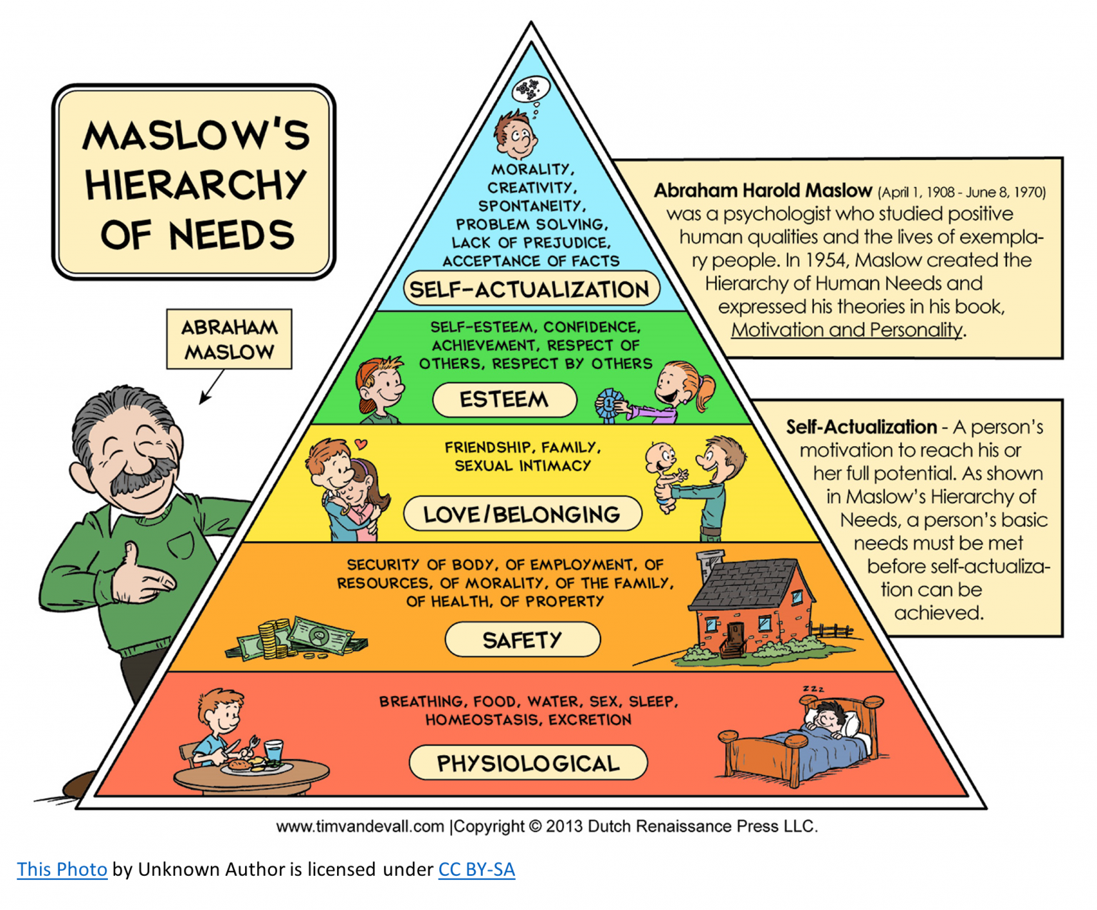
Compulsive Eating: Brainstorm
What role does food play in your life?
Have you ever participated in a gathering with friends of family with food?
When does food become a problem?
Have you ever used food to cope with a loss, stress, a difficult time?
Food is a basic physiological need and we need food to survive. Based on Maslow’s hierarchy of needs below, there are many other needs from physiological to safety all the way to self-actualization.

Slide 18
Food Addiction
Some individuals use food as a coping mechanism, like the way an individual would use a substance.
The biological reaction a body has is different to food than to a substance, however, it has been suggested that some eating habits, such as the uncontrolled intake of high-calorie food rich in sugar and fat can be referred to as “food addiction” (Sauvaget et al., 2015).

Slide 19
Compulsive Sexual Behaviours (CSB)
CSB is “characterized by recurrent and intense normophiliac or paraphilic sexually arousing fantasies, sexual urges, and behaviors that cause clinically significant distress in social, occupational, or other important areas of functioning” (Garcia & Thibault, 2010, p. 254).
Behaviours can include:
Masturbation
Pornography
Sexual Behavior with Consenting Adults
Cybersex
Telephone Sex
Strip Clubs

Slide 20
Similarities Between Substanse Abuse and CSB
Withdrawal symptoms such as:
Depression
Anxiety
Rumination
Guilt related to a reduction of sexual activities, as well as difficulties to stop or reduce the frequency of sexual activities” (p. 255).
*“Excessive sex in itself is not necessarily problematic” (Griffiths, 2016, p. 2017); it is when the behaviour becomes problematic for the individual that we can consider CSB as a problem.

Slide 21
Compulsive Internet Use: Brainstorm
Do you own a phone? A laptop? A desktop computer? How often do you use this/these devices?
What purpose do you use them for?
If you begin to quantify the time spent in front of a screen, would it surprise you?
Do you think there are risks associated with CIU and gaming?
This Photo by Unknown Author is licensed under CC BY-SA

Slide 22
Compulsive Internet Use (CIU)
Gaming is noted in the DSM-V as a behaviour being suggested as needing further research.
Risks include a sense of a loss of control, anxiety, depression, and a loss of social skill sets among others (Vasile et al., 2017).
Serious problems associated with CIU among adolescents include “refusal to attend school, cognitive problem, physical or psychological disorders, such as anxiety and depression” (Zhang et al., 2020, para. 1).
People who have CIU experience high levels of distress and negative consequences in their academic, professional, and personal lives(Kuss and Griffiths 2015).
Specialized treatment includes relaxation techniques, cognitive behavioural therapy, and journaling (Vasile et al., 2017).

Slide 23
Internet Addiction: Is It All In Your Brain?
https://youtu.be/8rGZpR5T-WU
(Demystifying Medicine, 2019).

Slide 24
Self Care
Please complete the activities at the end of chapter 5, and report back next class.

Slide 25
References
Allami, Y., Hodgins, D., Young, M., Brunelle, N., Currie, S., Dufour, M., & Nadeau, L. (2021). A meta-analysis of problem gambling risk factors in the general adult population. Addiction, 116(11), 2968-2977. https://doi.org/10.1111/add.15449
American Psychiatric Association. (2013). Diagnostic and statistical manual of mental disorders. 5th edition. https://journals.sagepub.com/doi/pdf/10.1177/070674371305800502
Canadian Partnership for Responsible Gambling (2015). Overview. http://www.cprg.ca/About
Centre for Addiction and Mental Health. (2018). Problem gambling and technology use treatment groups. https://www.camh.ca/-/media/files/pg-group_treatment-pdf.pdf
Centre for Addiction and Mental Health. (2021). Problematic sexual behaviours. https://www.camh.ca/-/media/files/community-resource-sheets/sexual-behaviours-resources-pdf.pdf
Chamberlain, S., Lochner, C., Stein, D., Goudriaan, A., Van Holst, R., Zohar, J., & Grant, J. (2015). Behavioural addiction—A rising tide? European Neuropsychopharmacology, 26(5), 841-855. https://pubmed.ncbi.nlm.nih.gov/26585600/
Demystifying Medicine. (2019, April 1). Internet addiction: Is it all in your brain? https://www.youtube.com/watch?v=8rGZpR5T-WU
Fattore, L., Melis, M., Fadda, P., & Fratta, W. (2014). Sex differences in addictive disorders. Frontiers in Neuroendocrinology,35(3), 272-284. https://doi.org/10.1016/j.yfrne.2014.04.003
Garcia, F., & Thibaut, F. (2010). Sexual addictions. The American Journal of Drug and Alcohol Abuse, 36(5), 254-260. https://pubmed.ncbi.nlm.nih.gov/20666699/
Grant, J. E., & Chamberlain, S. R. (2016). Expanding the definition of addiction: DSM-V vs. ICD-11. CNS Spectrums, 21(4), 300–303. https://doi.org/10.1017/S1092852916000183
Grant, J. E., Schreiber, L., & Odlaug, B. (2013). Phenomenology and treatment of behavioural addictions. Canadian Journal of Psychiatry, 58(5), 252-259. https://journals.sagepub.com/doi/pdf/10.1177/070674371305800502
Griffiths, M. (2016). Compulsive sexual behaviour as a behavioural addiction: The impact of the internet and other issues. Addiction, 111(12), 2107-2108. https://doi.org/10.1111/add.13315

Slide 26
References
Headspace. (2020). Small ways to practice self-care in difficult times: Andy Crisis Wisdom. [Video]. Youtube. https://www.youtube.com/watch?v=Mqqxi8mt4t0
Kingston, Frontenac, Lennox & Addington Public Health (2021). Prevalence of gambling disorders. https://www.kflaph.ca/en/research-and-reports/gambling-and-gaming-disorders.aspx
Kuss D. J., & Griffiths M. D. (2015). Internet addiction in psychotherapy. Palgrave Publishing.
Potenza, M., Higuchi, S., & Brand, M. (2018). Call for research into a wider range of behavioural addictions. Nature, 555(7694), 30. https://doi.org/10.1038/d41586-018-02568-z
Sauvaget, A., Trojak, B., Bulteau, S., Jiménez-Murcia, S., Fernández-Aranda, F., Wolz, I., & Grall-Bronnec, M. (2015). Transcranial direct current stimulation (tDCS) in behavioral and food addiction: A systematic review of efficacy, technical, and methodological issues. Frontiers in Neuroscience, 9, 349. http://dx.doi.org.libproxy.stfx.ca/10.3389/fnins.2015.00349
Sunrise Residential Treatment Centre. (2015, May). What is a process addiction? [Video]. YouTube. https://www.youtube.com/watch?v=oZjZcSOGj6o
The Fifth Estate. (2017, Dec. 8). Gambling on addiction: How governments rely on problem gamblers. [Video]. YouTube. https://www.youtube.com/watch?v=m3aDOTSqh94
Vasile, D., Vasiliu, O., Vasiliu, D., & Vasile, F. (2017). Cognitive behavioral therapy in Internet addiction – A case series. European Psychiatry, 41(S1), S784. https://doi.org/10.1016/j.eurpsy.2017.01.1496
Voon, V., Mole, T. B., Banca, P., Porter, L., Morris, L., Mitchell, S., Lapa, T. R., Karr, J., Harrison, N. A., Potenza, M., & Irvine, M. (2014). Neural correlates of sexual cue reactivity in individuals with and without Compulsive Sexual Behaviours. PLoS ONE, 9(7), 1-10. https://pdfs.semanticscholar.org/a413/18f2d3bb6c04796113 adb93c74e86ccd63b9.pdf?_ga=2.263209419.690242277.1636907049-69174705.1620417751
Williams, R. J., Volberg, R. A., & Stevens, R. M. (2012). The population prevalence of problem gambling: Methodological influences, standardized rates, jurisdictional differences and worldwide trends. Ontario Problem Gambling Research Centre. https://opus.uleth.ca/bitstream/handle/10133/3068/2012-PREVALENCE-OPGRC%20(2).pdf
Zhang, Y. Y., Chen, J. J., Ye, H., & Volantin, L. (2020). Psychological effects of cognitive behavioral therapy on internet addiction in adolescents: A systematic review protocol. Medicine, 99(4), e18456. https://doi.org/10.1097/MD.0000000000018456

