Slide 1
Exploring Substance Use in Canada. A Curriculum for Social Service Workers
Chapter 6: Theories

Slide 2
Learning Objectives:
Explore various theories of substance use
Compare and contrast theories
Discuss how theories impact service provision and prevention initiatives

Slide 3
Theories
Theories can help with:
Explaining why individuals use and abuse substances.
Interventions
Treatment
Prevention
Relapse and recovery.

Slide 4
Orientation to Theories of Substance Use
https://youtu.be/qQdc9leI
(Council on Social Work Education, 2021).

Slide 5
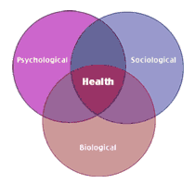
Theories Include
Moral Theory
Biological Theory
Psychological Theories
Social Theories
This Photo by Unknown Author is licensed under CC BY-SA

Slide 6
Theories of Substance Use Disorders
https://youtu.be/sf2HtrfwiQE
(ALLCEU Counselling, 2012).

Slide 7
The Origin of the Moral Approach
“Modern man (sic) begins to worry that any weakness of moral fiber in the exercise of self-restraint could lead him rapidly away from industry and towards indolence and even idiocy, by way of the bottle, the pipe or the syringe” (Wright 2015).
Discuss:
The moral model suggests using a substance is a moral failing which will lead to a path of destruction.

Slide 8
Moral Theory
“A large body of research indicates that this stigma is persistent, pervasive, and rooted in the belief that addiction is a personal choice reflecting a lack of willpower and a moral failing” (McGinty & Barry, 2020, p. 1291).
Examples of moral theory are still present today in statements like “pull up your bootstraps,” or “get over it,” in relation to substance use disorder. This can impact individuals who use substances, who may see themselves as having failed, especially when it comes to treatment and recovery.

Slide 9
Nuggets
https://youtu.be/HUngLgGRJpo
(Film Bilder & Friends, 2014).

Slide 10
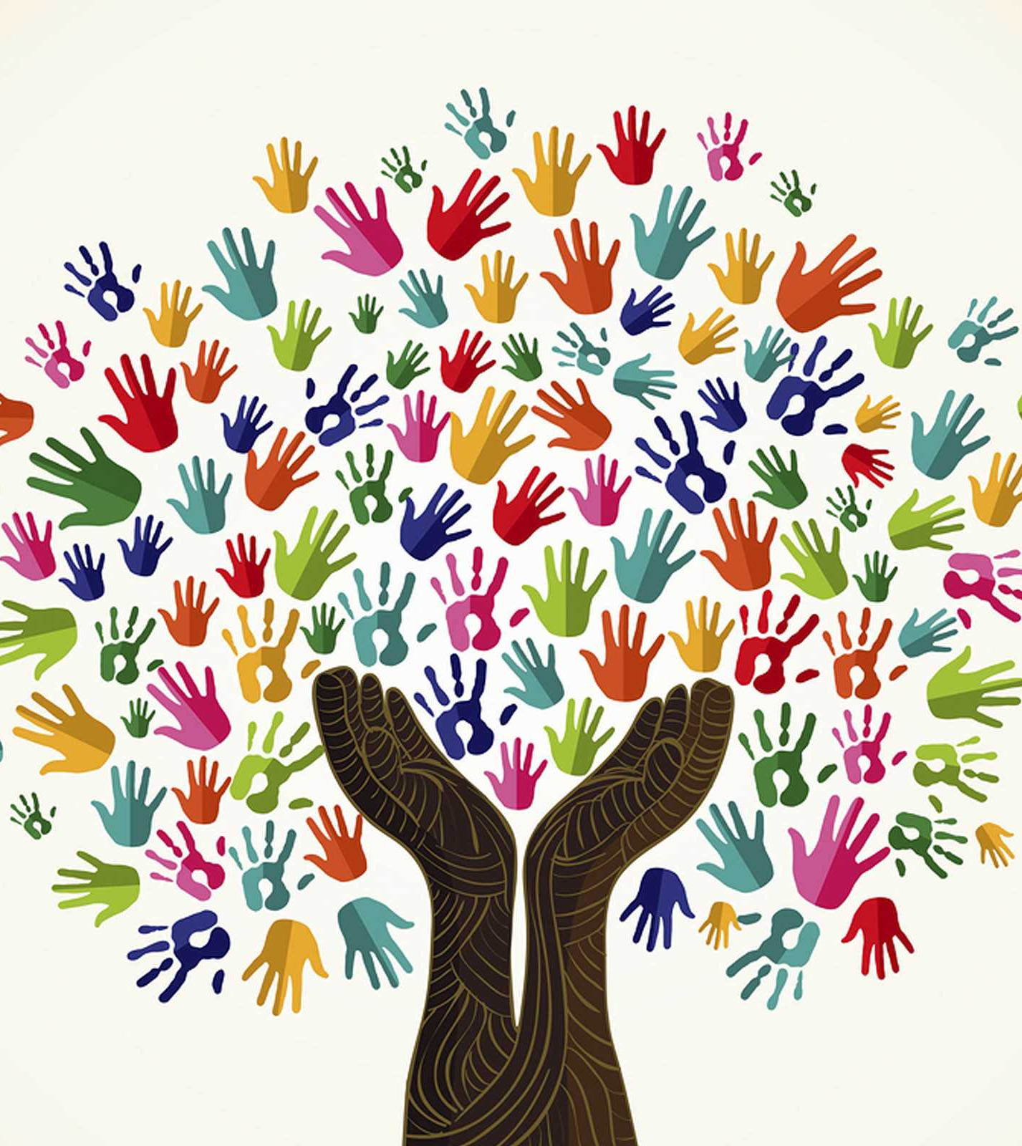
The Social Services Field and the Moral Model
The field of Social Services is working to move beyond a moral model of substance use disorders.
We can help people make their own decisions (self-efficacy)
We can advocate for services to improve the lives of people who use substances and live with SUDs.
This Photo by Unknown Author is licensed under CC BY-SA-NC

Slide 11
The Biology of Addiction: Killing Pain
https://youtu.be/yMoL4i28hVw
(Killing Pain, 2018).

Slide 12
Understanding the Biological Theory
For a person living with a substance use disorder, every time they use a substance it triggers adaptations in dopamine production
Biological theory focuses on how substances impact the brain, and can help with the development of treatment that focuses specifically on the brain:
Methadone Maintenance Treatment (MMT) is a treatment focuses on the biology of an opiate use disorder (Soyka et al., 2017).
Benzodiazepines can be used to target the biology of alcohol withdrawal symptoms (Soyka et al., 2017).
Mental health plays a role in substance use

Slide 13
Vulnerabilities and the Biological Theory
Adolescents and young adults, may be vulnerable to developing a substance use disorder at certain ages, due to the stages of brain development. Specific brain regions, like the amygdala typically mature slower, impacting decision making, which may be a reason why some youth struggle with substance use (Rutherford et al., 2010).
Some youth who have schizophrenia, and have not been diagnosed, use substances to manage their illness (Van Nimwegen, 2005).
Vulnerable individuals may be people who have a genetic predisposition (a parent or a close family member who has struggled with a substance use disorder)
Many studies do not allow us to separate the effects of genetic and environmental influences (Open Educational Resource, n.d.). This means that substance use disorders from a genetic perspective should not be considered simply a biological phenomenon

Slide 14
Learning Theory
Learning theory is an example of a psychological theory
Learning theory suggests that a substance use disorder results from the learning we receive from the social environment, our experiences (observing a peer or parent smoke or vape may influence whether a young person also begins smoking or vaping)
Observations “can instill positive expediencies for the effects of these substances and provide models that show how to obtain and use them” (Moos, 2007).
This Photo by Unknown Author is licensed under CC BY

Slide 15
Psychological Theories: Learning Models
Classical Conditioning
Operant Conditioning
Classical conditioning helps individuals understand their relationship with a substance and how they may crave a particular substance based on their environment. For example, someone who smokes tobacco may feel a pleasant feeling every time they visit a particular store, as that is the store where they buy cigarettes from, and often smoke as soon as they leave the store. “Common triggers that bring-on cravings include drinking coffee or alcohol, relaxing after work or after a meal, talking on the phone, driving, feeling stressed or angry” (Health Canada, 2021, para. 6). With classical conditioning, you can examine activators and help an individual identify strategies to reduce the emotions associated with the activators.
Operant conditioning uses the concept of rewards and punishments. If a person uses a substance, there are biological changes that happen (refer to Chapter 3 and 4). For some it is a pleasant feeling, for others, it is unpleasant. Not every person who uses a substance will develop a disorder; for some the pleasant feeling is just that, a pleasant feeling. For others the pleasant feeling takes over, and the reward becomes the focus. This focus can then develop into a substance use disorder. The Community Reinforcement Approach builds on operant conditioning; “the goal of CRA is to help people discover and adopt a pleasurable and healthy lifestyle that is more rewarding than a lifestyle filled with using alcohol or drugs” (Meyers et al., 2011, para. 7).

Slide 16
Social Connections
Social connections are critical for our development as babies, toddlers, youth and into adulthood. They play a role in what we do, how we act, and how we live
Social connections are also important for our health. In the beginning days of the COVID-19 pandemic, many people were negatively impacted by the social gathering restrictions. Some people increased their substance use to cope with the isolation (Public Health Agency of Canada, 2021). Some people used technology to connect with family, friends, and even with their workplace
Many of the treatment models use a social-ecological approach, identifying factors like trauma, adverse childhood experiences, mental health, racism, as well as self-efficacy.

Slide 17
Social Learning Theory
Social learning theory suggests behaviour is influenced by the interaction of the following factors:
Personal
Social
Environmental
Intrapersonal factors
Interpersonal factors
Institutional factors
Organizational factors
Community factors
Public policy
(McLeroy, 1988).
This Photo by Unknown Author is licensed under CC BY-ND

Slide 18
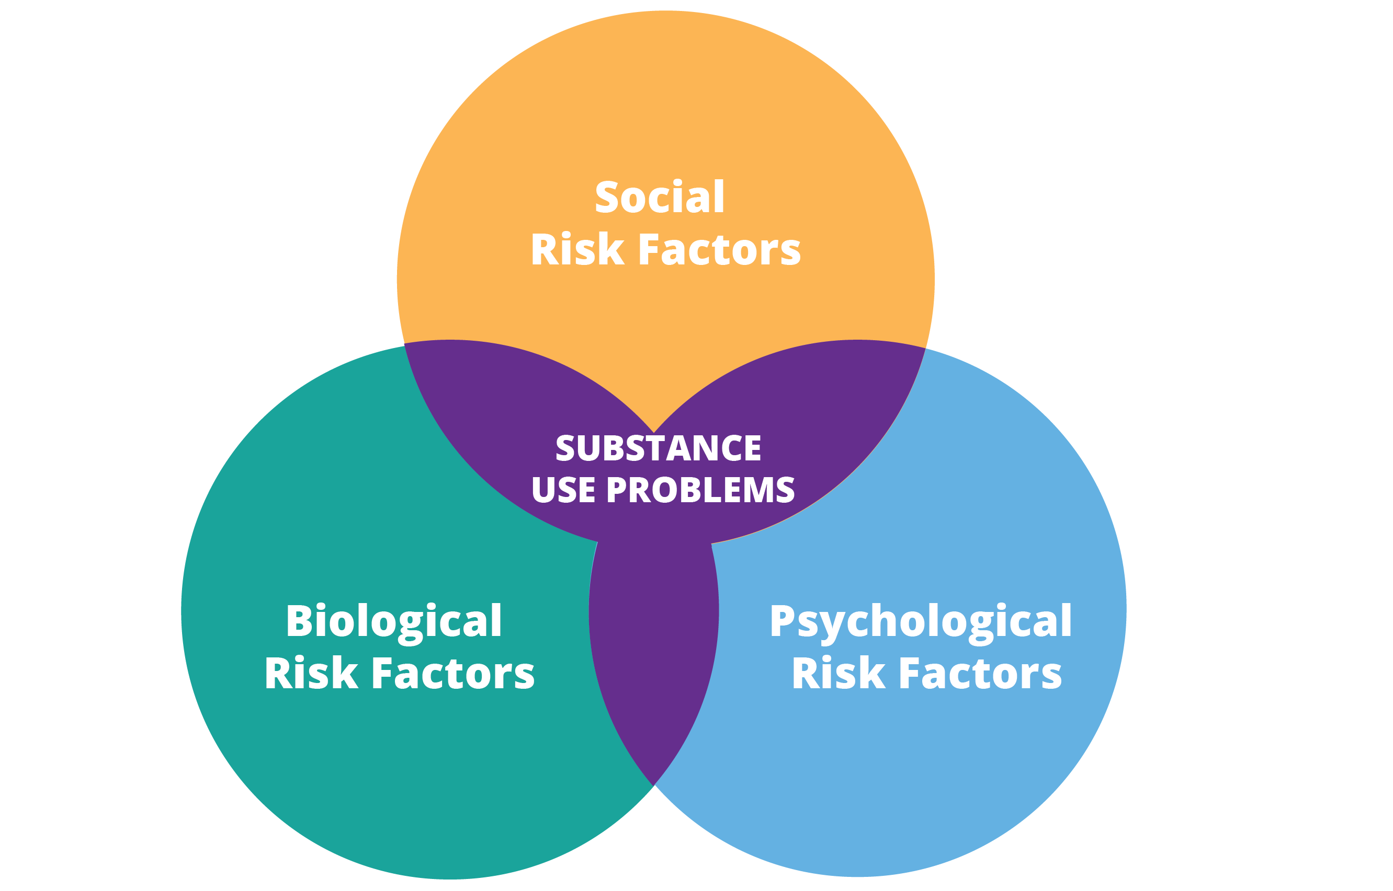
Substance use disorders as biopsychosocial phenomemon
To look at substance use disorders in a binary fashion, choosing one lens or another is not effective. Breaking down substance use and connecting it to biological factors, psychological factors, and social factors can help provide Social Service workers an opportunity to see a “whole” person and to provide wrap-around supports that can help a person meet their individual goals related to their substance use.
You can further explore poverty, race, gender, and other examples of intersectionality that may play a role in a person’s substance use as you are working with them, ensuring your work is culturally and gender sensitive.
(Brown-Rice & Moro, 2018).

Slide 19
Social Connections
https://youtu.be/x1EYcVpQeeE
(Every Mind Matters, 2019).

Slide 20
Trauma
A traumatic experience can be something that happens to us, for example an accident or a loss. A traumatic experience can cause trauma; trauma is NOT necessarily something that happens each time a difficult situation arises in your life
The Canadian Association of Mental Health (2021) describes trauma as “the lasting emotional response that often results from living through a distressing event
Experiencing a traumatic event can harm a person’s sense of safety, sense of self, and ability to regulate emotions and navigate relationships” (para. 1).
Trauma as an initial or latent experience can happen at any time at any place.

Slide 21
Dr. Gabor Mate
Dr. Gabor Mate (2021) considers trauma as “the invisible force that shapes our lives. It shapes the way we live, the way we love and the way we make sense of the world. It is the root of our deepest wounds” (para. 6).
This Photo by Unknown Author is licensed under CC BY-SA

Slide 22
Trauma and Addiction: Crash Course Psychology #31
https://youtu.be/343ORgL3kIc
(CrashCourse, 2014).

Slide 23
What qualifies as trauma?
Holmes (2021) suggests trauma must include “stigmatization, marginalization, or oppression because of gender, sex, race, class, sexual orientation, age, ethnicity, culture, spirituality, ability/disability” (p. 24).
Trauma is complex and must be understood as not necessarily having just one experience.
Other researchers suggest “trauma has been found to contribute to a range of mental health conditions” (Cleary et al., 2020, para. 1) and for some, coping with trauma means using substances (Saddichha et al., 2015).
When trauma affects people’s coping mechanisms, they may not be able to appropriately respond to any stressors, much less recover (Cleary et al., 2020).

Slide 24
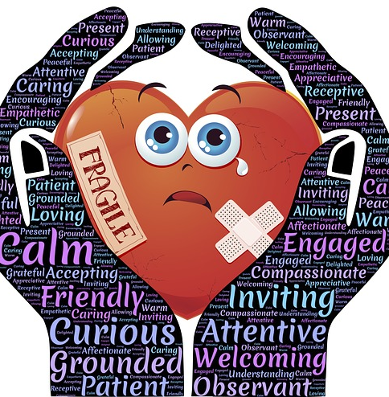
Trauma Informed Care
Trauma informed care recognizes the prevalence of trauma, how it manifests and impacts people and focuses on supporting the needs of an individual while minimizing the risk of re-traumatisation, and maximizing choice and empowerment (Cleary, 2020).
When trauma and a substance use disorder are connected, it is imperative that a trauma-informed approach is used
This Photo by Unknown Author is licensed under CC BY-SA

Slide 25
Self Care
Please participate in guided meditation as an act of self care and report back next class.

Slide 26
References
ALLCEU Counselling. (2012, July 18). Theories of addiction. [Video]. YouTube. https://www.youtube.com/watch?v=sf2HtrfwiQE&feature=emb_imp_woyt
Brown-Rice, K., & Moro, R. (2018). Genetics and brain chemistry. In P. Lassiter, & J. Culbreth (Eds.), Theory and practice of addiction counseling (pp. 47-75). SAGE Publications, Inc.
Cleary, M., West, S., Kornhaber, R., Visentin, D., Neil, A., Haik, J., & McLean, L. (2020). Moving the lenses of trauma — Trauma-informed care in the burns care setting. Burns, 46(6), 1365-1372. https://doi-org.libproxy.stfx.ca/10.1016/j.burns.2020.01.01
Council on Social Work Education. (2021). Orientation to theories of substance use. [Video]. Youtube. https://www.youtube.com/watch?v=qQdlvZc9leI&feature=emb_imp_woyt
Crash Course. (2014, Sept. 22). Trauma and addiction: Crash course psychology #31. [Video]. Youtube. https://www.youtube.com/watch?v=343ORgL3kIc
Every Mind Matters. (2019). Social connection. [Video]. Youtube. https://www.youtube.com/watch?v=x1EYcVpQeeE
FilmBilder & Friends. (2014, Oct. 13). Nuggets. [Video]. Youtube. https://www.youtube.com/watch?v=HUngLgGRJpo
Health Canada. (2021). How to quit smoking. https://www.canada.ca/en/health-canada/services/smoking-tobacco/quit-smoking/how.html#a4
Homes, C. (2021). Bridging the gap in women’s substance use services: A trauma-informed, gender-responsive, and anti-oppressive approach. http://repository.cityu.edu/bitstream/handle/20.500.11803/1465/ChristineHolmesCapstone.pdf?sequence=2&isAllowed=y\
Mate, G. (2021). The wisdom of trauma. https://drgabormate.com/the-wisdom-of-trauma/
McLeroy, K. R., Bibeau, D., Steckler, A., & Glanz, K. (1988). An ecological perspective on health promotion programs. Health Education Quarterly, 15(4), 351-77. https://doi.org/10.1177%2F109019818801500401
Meyers, R. J., Roozen, H. G., & Smith, J. E. (2011). The community reinforcement approach: an update of the evidence. Alcohol Research & Health: The Journal of the National Institute on Alcohol Abuse and Alcoholism, 33(4), 380–388. https://www.ncbi.nlm.nih.gov/pmc/articles/PMC3860533/
Moos, R. H. (2007). Theory-based processes that promote the remission of substance use Disorders. Clinical Psychology Review, 27(5), 537-551, https://doi.org/10.1016/j.cpr.2006.12.006.
Open Educational Resource. (n.d.). Theories of addiction: Causes and maintenance of addiction. Chapter 4. https://www.open.edu/openlearn/ocw/pluginfile.php/629967/mod_resource/content/1/addictionarticle1teeson.pdf

Slide 27
References
Public Health Agency of Canada. (2021). COVID-19: Focus on substance use and stigma. https://www.canada.ca/en/public-health/news/2021/05/covid-19-focus-on-substance-use-and-stigma.html
Rutherford, H. J., Mayes, L. C., & Potenza, M. N. (2010). Neurobiology of adolescent substance use disorders: implications for prevention and treatment. Child and Adolescent Psychiatric Clinics of North America, 19(3), 479–492. https://doi.org/10.1016/j.chc.2010.03.003
Saddichha, S., Werker, G., Schuetz, C., & Krausz, M. (2015). Stimulants and cannabis use among a marginalized population in British Columbia, Canada. International Journal of Offender Therapy and Comparative Criminology, 59(13), 1487-1498. https://doi.org/10.1177%2F0306624X14541661/
Soyka M., Kranzler, H. R., Hesselbrock, V., Kasper, S., Mutschler, J., Möller H. J., & The WFSBP Task Force on Treatment Guidelines for Substance Use Disorders. (2017). Guidelines for biological treatment of substance use and related disorders, part 1: Alcoholism, first revision. The World Journal of Biological Psychiatry, 18(2), 86-119. https://books.google.ca/books?hl=en&lr=&id=sWtwAAAAQBAJ&oi=fnd&pg=PT8&dq=behavioural+theory+addiction&ots=Lv9CW4hdLO&sig=sEK–99BluIaVzBJsoGDadb9or8#v=onepage&q=behavioural%20theory%20addiction&f=false
The Canadian Association of Mental Health. (2021). Trauma. https://www.camh.ca/en/health-info/mental-illness-and-addiction-index/trauma
Trealeven, D. (2021). Resilience, mindfulness, and healing trauma. https://davidtreleaven.com/tsm-podcast-episode-22-anjuli-sherin
van Nimwegen, L., de Haan, L., van Beveren, N., van den Brink, W., & Linszen, D. (2005). Adolescence, schizophrenia and drug abuse: a window of vulnerability. Acta Psychiatrica Scandinavica, 111(s427), 35-42. https://doi.org/10.1111/j.1600-0447.2005.00543.x
Wright, C. (2015). Consuming habits: Today’s subject of addiction. Subjectivity, 8, 93–101. https://doi.org/10.1057/sub.2015.6

