Slide 1
Human Resources Management 3rd Edition
Chapter 10: Labour Relations
Unless otherwise noted, this work is licensed under a Creative Commons Attribution-NonCommercial-ShareAlike 4.0 International (CC BY-NC-SA 4.0) license. Feel free to use, modify, reuse or redistribute any portion of this presentation.

Slide 2
Learning Outcomes
Discuss the history of labour unions.
Explain reasons for a decline in union membership over the past four decades.
Explain the process of unionization and laws that relate to unionization.
Describe the process of collective bargaining.
Explain the types of bargaining issues and the rights of management.
Discuss how to manage the grievance process.
Explain HR role working with unions.

Slide 3
10.1 Definition and History Of Unions
A labour union or union, can be defined as employees banding together to meet common goals, such as better pay, benefits, or promotion rules. It has a legal obligation to the employees to: represent them, negotiate on their behalf with management and monitor the collective agreement.
Labour Day – celebrates the right to fair wages, safe working conditions and injury compensation, and equitable labour relations.
Craft unions first arose in Canada in the 1820s
The first union action in Canada occurred when the Toronto Typographical Union went out on strike in 1872
The rapid industrialization associated with the first World War led to a rapid growth of the labour movement in the country.
The post-war era saw union membership soar to four million members in the 1990’s.

Slide 4
10.2 Reasons For Unionization
Employees join unions to be represented by a large entity to increase wages, benefits, to establish a seniority list, job security and have a mechanism in place for grievances against the company/management.
When employees are making decisions whether to join a union or not, they generally take into consideration a variety of factors
Unions impact wages and increases in wages, and retirement pensions.
They can affect how companies hire employees, and how many employees (more or less employees).
Unionized has dropped mostly because of the shift from manufacturing to the service sector.
While there was a decline among men in unionization, there was an increase for women.
Notes:
Factors when joining a union:
Satisfaction versus dissatisfaction with the employer and/or their job
Personal attitudes related to unions from media, other employees, past history with unions, parental upbringing (a “for” or “against” unions attitude)
a belief about what a union can “do” for employees to improve working conditions
Some employees may not have a desire to join unions, or see it as a great opportunity. Some of these considerations include:
An employee who has had a former poor experience with unions
Employees may feel the employer is doing a good job of treating them fairly and equally
Some employees feel it is just another layer of “management” as an authority
Some employees may fear repercussions from unionization from management ie. looking to be promoted in the future to management
Employees do not want to go on strike, if needed, and lose their pay cheques, or pay union dues

Slide 5
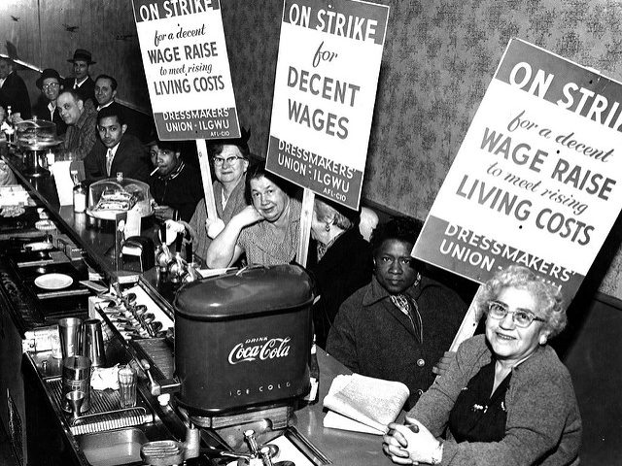
10.3 Union Objectives and Structures
Unions change the face of the work place, the relationships between management and employees, and the role of HR departments.
The unions role is sometimes called business unionism which means to improve working conditions for unions, protect the employee’s interests, improve wages and benefits, and improve working conditions.
Politics and economics play a factor in this type of union called social unionism or reform unionism
Unions have a pyramidal structure much like that of large corporations (i.e. locals and stewards).
This Photo by Cornell University Library is licensed under CC BY-ND
Notes:
Here are the basic units that compose unions:
Local represents workers in their own workplace or town (e.g., Quebec Crane Operator, Local 791G)
Parent union decides on union policy for all locals across the province, country or world (e.g., CSN, FTQ)
National unions represent union members across the country (e.g. PSA, Unifor).
International unions represent union members in more than one country (e.g. UAW, Teamsters).
Central labour organizations do not negotiate union contracts but lobby government to pass laws favourable to unions (e.g. Canadian Labour Congress).

Slide 6
10.4 Legislation And Unions
Legislation and Unionization
The path to unionization and the process of maintaining a union is heavily regulated.
To ensure the labour relations between management and unions is enforced, labour boards are created at federal and provincial levels to administer the legislation.
When organized as a group, employees gain some power and can start leveraging that power to negotiate with their employer.
The government in Canada sets the framework for unions and management through laws and role as an employer
Core elements of labour law include:
Right to join a union
Must bargain in good faith
No strikes or lockouts during the time of the collective agreement:
No unfair labour practices
Conciliation
Notes:
Core elements of labour law explained:
Right to join a union: all employees have the right to join and participate in a union
Must bargain in good faith: each party must negotiate “in good faith” which means to make a reasonable effort to reach and agree to a collective agreement through meeting each other and exchanging proposals that are sincere in reaching an agreement
No strikes or lockouts during the time of the collective agreement: it is considered illegal for employees to strike and for the employer to lock out the employees during the time of the contract
No unfair labour practices: all jurisdictions have laws prohibiting any unfair labour practices by the union or the employer ie. false advertising of goods and services, deceptive pricing, noncompliance with set standards, no coercing of employer or employees in exercising their right
Conciliation: the union and the employer must participate in conciliation processes before a lock out or a strike.

Slide 7
10.5 Collective Bargaining Process
Collective bargaining is the process of negotiations between the company and representatives of the union.
Unions are created only when employees want to create them.
Once an organizing drive has begun, management’s responses are limited.
3 Ways to be recognized as a union:
Voluntary recognition, regular certification, and prehearing votes:
In a collective bargaining process, both parties are legally bound to bargain in good faith. This means they have a mutual obligation to participate actively in the deliberations and indicate a desire to find a basis for agreement.

Slide 8
10.5. Steps in Collective Bargaining
Step 1. Preparation of both parties.
Step 2. Parties agree on the timelines and ground rules
Step 3. Each party presents initial proposals face-to-face
Step 4. Proposals discussed and new meetings take place
Step 5. Details settled, contract written and voted on by members

Slide 9
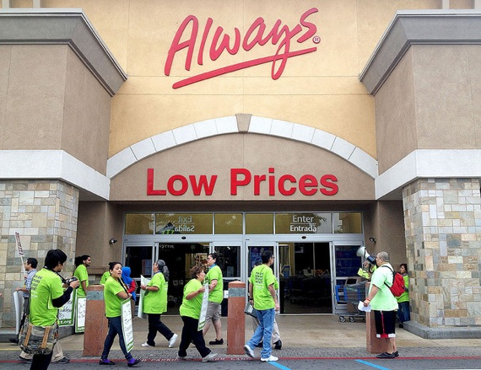
10.5 Bargaining Impasse and Pressure Tactics
When the two parties are unable to reach consensus on the collective bargaining agreement, this is called a bargaining impasse.
Pressure tactics are allowed by the law but they must respect certain parameters.
Unions have several options at their disposal to pressure company management into accepting the terms and conditions. The tactics available to the union include striking, picketing, and boycotting.
One tactic available to management is the lockout
This Photo from Flickr by Matt Hamilton is licensed under CC BY

Slide 10
10.6 The Collective Bargaining Agreement
The grievance procedure outlines the process by which perceived contract violations can be handled
A violation of the contract terms or perception of violation normally results in a grievance which is a formal procedure when the union and management disagree on the interpretation of the collective agreement
A mediator may be called in, who acts as an impartial third party and tries to resolve the issue.
An arbitrator is an impartial third party who is selected by both parties and who ultimately makes a binding decision in the situation.
Notes:
Collective Agreement Provisions
Seniority: Unions generally want decisions made by the length of service of employees or seniority. This way longer serving employees are guaranteed no favouritism related to overtime, layoffs and promotions.
Security: Unions prefer closed shop which ensures employees become union members and pay union dues. This is all decided before employees are hired. Union shops is a security measure that allows employers to hire whomever they wish, however, they must join the union with a specific time frame and pay union dues. If an employee does not wish to join the union, they are terminated. The Rand Formula ensures employers deduct union dues from an employee’s wages. In some jurisdictions, union dues are negotiated, while in other jurisdictions it is law. In an open shop, employees do not have to join the union and do not pay union dues.
Disciplinary Practices: Within the collective agreement, a clause would be included for discipline and/or discharge of an employee for “just cause”. According to Vey Willetts, LLP (n.d.), “…just cause must be able to show that the employee’s conduct was of such a degree that it was no longer compatible with ongoing employment. The key is that the sanction imposed (termination) must be proportional to the misconduct in question.
Most grievances fall within one of four categories:
Individual/personal grievances
A group grievance
A principle grievance
Union or policy grievance

Slide 11
10.7 The Future of Unions
The labour movement is currently experiencing several challenges, including a decrease in union membership, globalization, and employers’ focus on maintaining non-union status.
To fully understand unions, it is important to recognize the global aspect of unions.
Globalization is also a challenge in labour organizations today.
Companies are on a quest to maintain a union-free work environment. In doing so, they try to provide higher wages and benefits so workers do not feel compelled to join a union. Companies that want to stay union free constantly monitor their retention strategies and policies.

Slide 12
10.8 Human Resources In Union Workplaces
Unions and HR departments need to work together.
The HR department takes on the responsibility of bridging the gap between opposing parties during negotiations.
Communication is critical to labour relations.
HR can help union and management to find common goals
This Photo by Niskanen Center is licensed under CC BY

Slide 13
Summary
Discuss the history of labour unions.
Explain reasons for a decline in union membership over the past four decades.
Explain the process of unionization and laws that relate to unionization.
Describe the process of collective bargaining.
Explain the types of bargaining issues and the rights of management.
Discuss how to manage the grievance process.
Explain HR role working with unions.

Slide 14
End Chapter Review
Discuss the most important reasons why employees want to unionize? Brainstorm in large group.
Research online United States unions. What are the major differences between unions in the United States versus Canada? Individual research. Share with a partner.
What are the differences between craft unions and trade unions? Share with a partner.
Research the role of a Union Steward. Individual. What are the primary responsibilities of a Union Steward? List them and share with a partner.
Why did unions decide to join together to create international associations? Share with a partner.

Slide 15
End Chapter Review
Review the Fortune 500 Focus related to Walmart. Do you believe this story has impacted other union campaigns? How? Share with a partner.
As an individual, do you support unions? What do you think your support/lack of support for unions is influenced by? Would you work for a unionized company? Why? What not? Discuss in a small group.
Part time workers appear to have difficulty unionizing? What do you think the reasons for this is? Share with a partner.
Statistics suggest that unionizing for men has been declining over the years. Complete some research, individually. Discuss your research with a partner.
There has been a shift to social unionism with unions. What do you think the reasons are for this shift? Discuss in a small group.

Slide 16
End Chapter Review
As the HR Manager of a company, you have an employee come to and shares they have been approached by another employee about a union campaign that was started. The employee is anti-union, and does not want to join a union. What do you do with this information? Share in a small group.
You, as the HR Manager, have been asked by the President of the company to lead the first negotiations with the union employees. What information do you need to gather? Who do you need to involve? Share in a small group.
You, as the HR Manager, have been asked to provide information for the union-management team related to new employee demands for the upcoming union negotiations. The employees want more money, better health benefits, more vacation, and a change to job classifications. What type of data can you provide to the union-management team? Share in a small group.

