Slide 1
Project Schedule Planning

Slide 2
Project Schedule Planning
The Project Schedule
Defining Activities
Case study of WBS development
Activity definition and Task dependencies
Leads and lags
. . . continued on next slide

Slide 3
Project Schedule Planning (continued)
Milestones
Activity Sequencing
Gantt Chart
Network Diagram
Critical Path

Slide 4
The Project Schedule
A project schedule includes
the sequence of activities,
the duration planned for each activity, and
relationships or dependencies between the beginnings and ends of different activities.
The project schedule is created
AFTER the scope planning has created the WBS
BEFORE project resource planning

Slide 5
Review: Scope Planning
WBS breaks down the deliverables into smaller units, ending with the work packages.
A work package is a clearly defined activity or group of activities whose duration can be estimated.

Slide 6
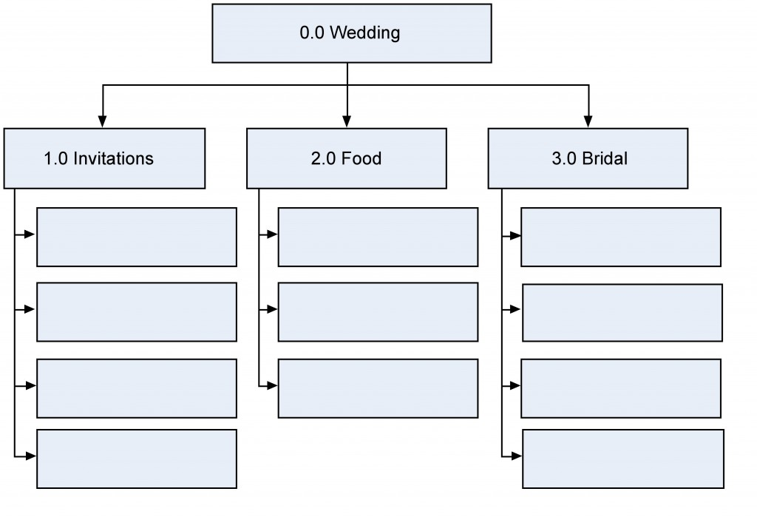
Case Study: Wedding Deliverables

Slide 7
Deliverables Decompose into Work Packages
Shop for shoes
Create guest list
Tailoring and fitting
Shop for dress
Find caterer
Cater the wedding
Wait for RSVPs
Mail the invitations
Finalize the menu
Print the invitations
Choose the bouquet

Slide 8
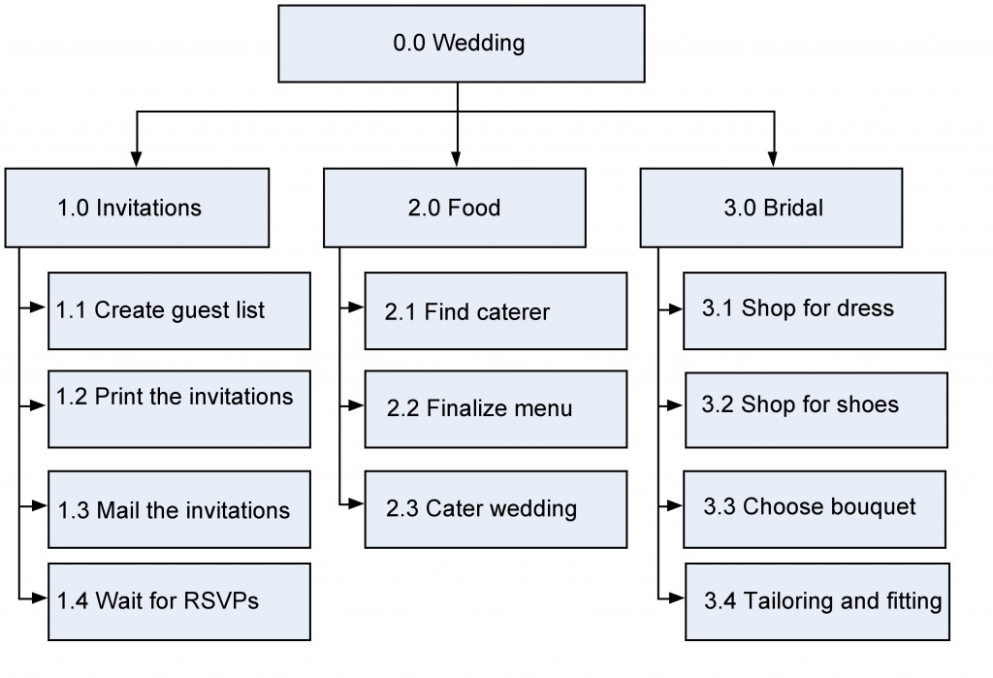
Case Study: Wedding Deliverables

Slide 9
Remember
WBS follows 100% rule
There is no sequencing of tasks in the WBS

Slide 10
Task Dependencies
Finish-to-start

Slide 11
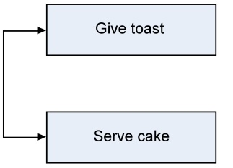
Task Dependencies
Start-to-start

Slide 12
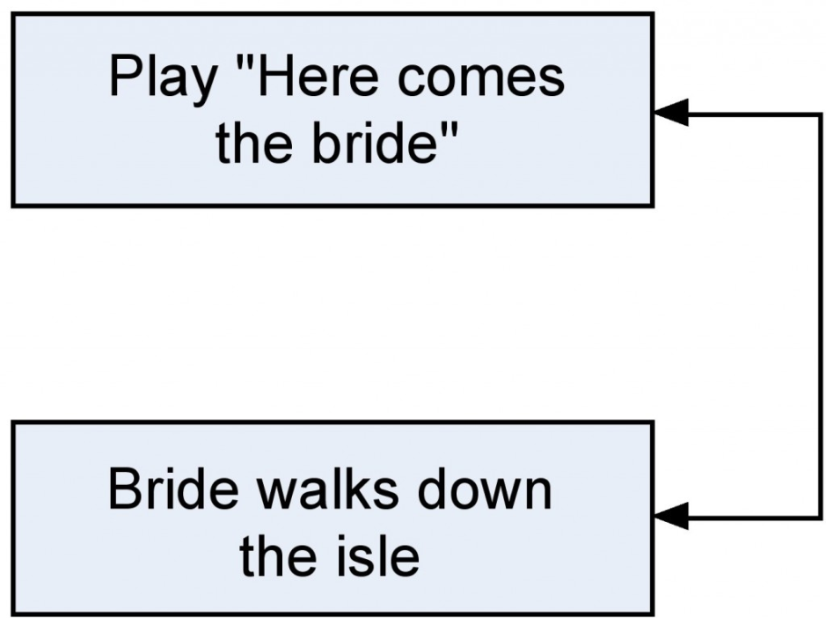
Task Dependencies
Finish-to-finish

Slide 13
Types of predecessors
External predecessors
Outside the project, such as the previous party being out of the reception hall
Discretionary predecessors
Matter of preference: bridesmaids arrive before couple
Mandatory predecessors
Cannot do the following task until the predecessor is done: invitations must be addressed before they can be mailed

Slide 14
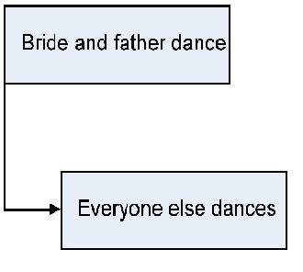
Leads and Lags
Lag: One task must wait in relation to another task:

Slide 15
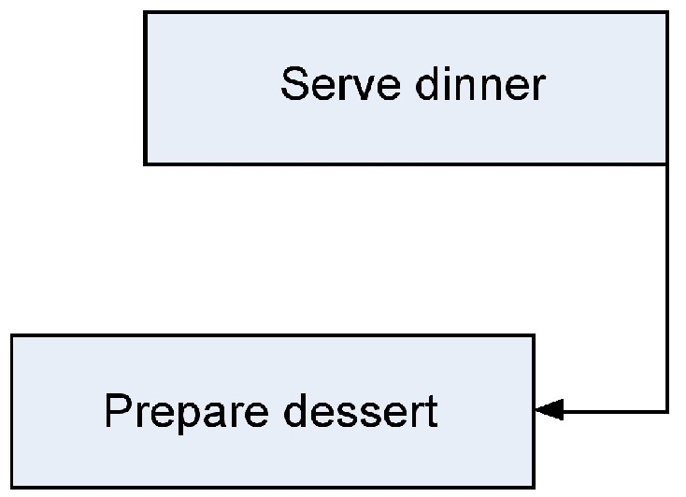
Leads and Lags
Lead: The task must start before the predecessor is done:

Slide 16
Milestones
A milestone is an important checkpoint—usually completion of a major task or a major set of tasks.
Target dates will be set later

Slide 17
Milestones in Wedding Plan
Invitations Sent
Menu Finalized
Location booked
Bridesmaids’ dresses fitted

Slide 18
Creating a Gantt Chart
Gantt Chart is a horizontal bar chart with a list of activities on the left and a timeline on the horizontal axis.
A traditional Gantt chart does not show dependencies; many current Gantt charts add the critical path and arrows to indicate tasks that precede other tasks.

Slide 19
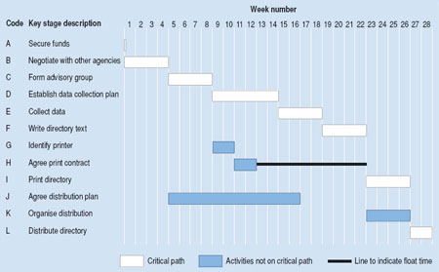
Gantt Chart for Wedding Plan

Slide 20
Network Diagram
Also known as PERT chart or PERT/CPM chart
Illustrates task relationships
Used to determine the critical path
Software such as Microsoft Project can be used to create a network diagram.

Slide 21
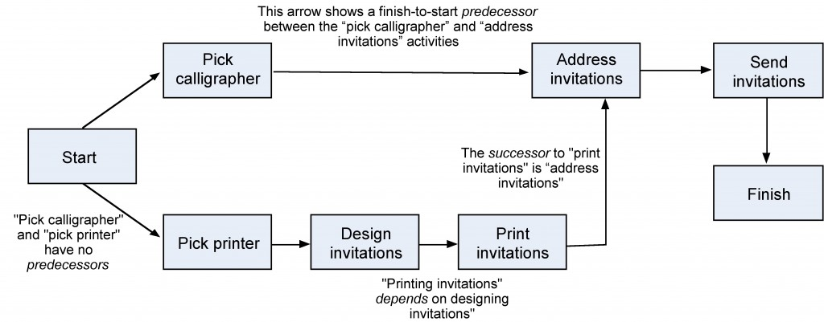
Network Diagram for Wedding

Slide 22
Network Diagram: Activity on Arrow
Alternative method
More difficult to read and understand
May require the creation of dummy activities when a task has multiple predecessors and multiple dependent tasks
More “mathematical” in its illustration of activities and events.

Slide 23
The critical path
When multiple paths exist through the network diagram, the path with the longest duration is called the critical path
If any task on the critical path is delayed, the project is delayed
Tasks NOT on the critical path have slack available. This is the amount of time the task could be delayed without delaying the completion of the project

Slide 24
Critical Path Example

Slide 25
Critical Path Example
In this example the critical path is A,B,C,D,E,F,I,L, and the earliest completion date for the project is the sum of the estimated times for all the stages on the critical path – 28 weeks

Slide 26
Slack
Slack is the amount of time a task could be delayed without delaying the completion of the project
Tasks on the critical path have zero slack
For tasks NOT on the critical path, work backwards from the project duration to determine the amount of slack

Slide 27
Slack on Critical Path Example
In this example the slack for task K is 2 weeks. If task K is delayed by less than two weeks, it will not delay the completion date of the project.

Slide 28
Types of Slack
Total Slack
Allowable delay of an activity without delaying project completion (usual meaning of “Slack” if not specified)
Free Slack
Allowable delay of an activity without affecting the earliest start of any dependent (following) activity
Safety Slack
Remaining allowable delay of an activity if all predecessors finish as late as possible

Slide 29
Network Diagram compared to Gantt
Network diagram is more technical, helps determine the critical path
Network diagram is not to a scaled timeline
Gantt is easy to read and explain to non-technical people
Gantt has a good method for graphically illustrating task progress and whether things are ahead of schedule or behind

Slide 30
Network Diagram compared to Gantt
Project managers depend on network diagram to plan and to adjust
Gantt is developed from network diagram for purposes of communicating the plan
Both are easily produced from project management software

Slide 31
Finalizing the Project Schedule
May have to negotiate with sponsor or adjust customer expectations
Schedule will be impacted by Project Resource plans
Monitor the critical path tasks most closely

Slide 32
Project Schedule Planning Summary
The Project Schedule shows when each activity will take place and the dependencies between activities
Activities or work packages are derived from the WBS, which was developed in Project Scope Planning
Task dependencies may be
Finish to start
Start to start
Finish to finish
Leads and lags
. . . continued on next slide

Slide 33
Project Schedule Planning Summary (continued)
Milestones are checkpoints
Activity Sequencing is determined by the dependencies
Gantt Chart is a horizontal timeline showing when each activity is scheduled, along with optional indicators of task progress
Network Diagram helps Project Managers illustrate task dependencies and determine the critical path
. . . continued on next slide

Slide 34
Project Schedule Planning Summary (continued)
Tasks on the critical path have no slack
If a critical path task is delayed, project completion will be delayed
Tasks not on the critical path have slack.
If a non-critical task is delayed by less than the slack, project completion will not be delayed.
. . . continued on next slide

Slide 35
Project Schedule Planning Summary (continued)
After the schedule is developed:
Get approval from sponsor; may require some negotiations
Next step will be to develop the project resource plan
Project Resource Planning may cause schedule adjustments

Slide 36
Questions?

