Slide 1

Principles of Macroeconomics
CHAPTER 3: DEMAND AND SUPPLY
Unless otherwise noted, this work is licensed under a Creative Commons Attribution-NonCommercial-ShareAlike 4.0 International (CC BY-NC-SA 4.0) license. Feel free to use, modify, reuse or redistribute any portion of this presentation.

Slide 2
Learning Outcomes
At the end of this chapter, you will be able to:
Explain Demand and Quantity demanded
Discuss variables that influence demand
Describe Supply and Quantity supplied
Elaborate variables that influence supply
Illustrate Market Equilibrium
Use demand-supply graphs to predict changes in price and quantity

Slide 3
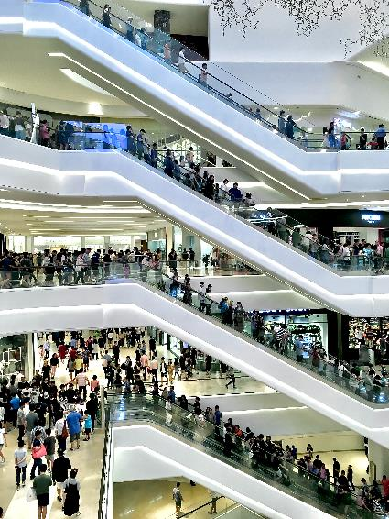
3.1 Demand
Price and Quantity Demand
While different variables play different roles in influencing the demands for different goods and services, economists pay special attention to one: The price of the good or service.
Given the values of all the other variables that affect demand, a higher price tends to reduce the quantity people demand, and a lower price tends to increase it.
Photo by Heamosoo Kim, licensed under the Unsplit License
Notes:
We will discuss first how price affects the quantity demanded of a good or service and then how other variables affect demand. Because people will purchase different quantities of a good or service at different prices, economists must be careful when speaking of the “demand” for something. They have therefore developed some specific terms for expressing the general concept of demand.
The quantity demanded of a good or service is the quantity buyers are willing and able to buy at a particular price during a particular period, all other things unchanged (“ceteris paribus” in Latin).

Slide 4

3.1 Price and Quantity Demand Example
A medium pizza typically sells for $5 to $10. Suppose the price was $30. Chances are, you would buy fewer pizzas at that price than you do now. Suppose pizzas typically sold for $2 each. At that price, people would be likely to buy more pizzas than they do now.
Photo by Shourav Sheikh, licensed under the Unsplit License
Notes:
We will discuss first how price affects the quantity demanded of a good or service and then how other variables affect demand. Because people will purchase different quantities of a good or service at different prices, economists must be careful when speaking of the “demand” for something. They have therefore developed some specific terms for expressing the general concept of demand.
The quantity demanded of a good or service is the quantity buyers are willing and able to buy at a particular price during a particular period, all other things unchanged (“ceteris paribus” in Latin).

Slide 5
3.1 Demand Example
Suppose, for example, that 100,000 movie tickets are sold each month in a particular town at a price of $8 per ticket. That quantity—100,000—is the quantity of movie admissions demanded per month at a price of $8.
If the price were $12, we would expect the quantity demanded to be less.
If it were $4, we would expect the quantity demanded to be greater.
The quantity demanded at each price would be different if other things that might affect it, such as the population of the town, were to change. That is why we add the qualifier that other things have not changed to the definition of quantity demanded.
Notes:
A demand schedule is a table that shows the quantities of a good or service demanded at different prices during a particular period, all other things unchanged. To introduce the concept of a demand schedule, let us consider the demand for coffee in Canada. The table in the figure below shows quantities of coffee that will be demanded each month at prices ranging from $9 to $4 per pound; the table is a demand schedule. We see that the higher the price, the lower the quantity demanded and vice versa.

Slide 6
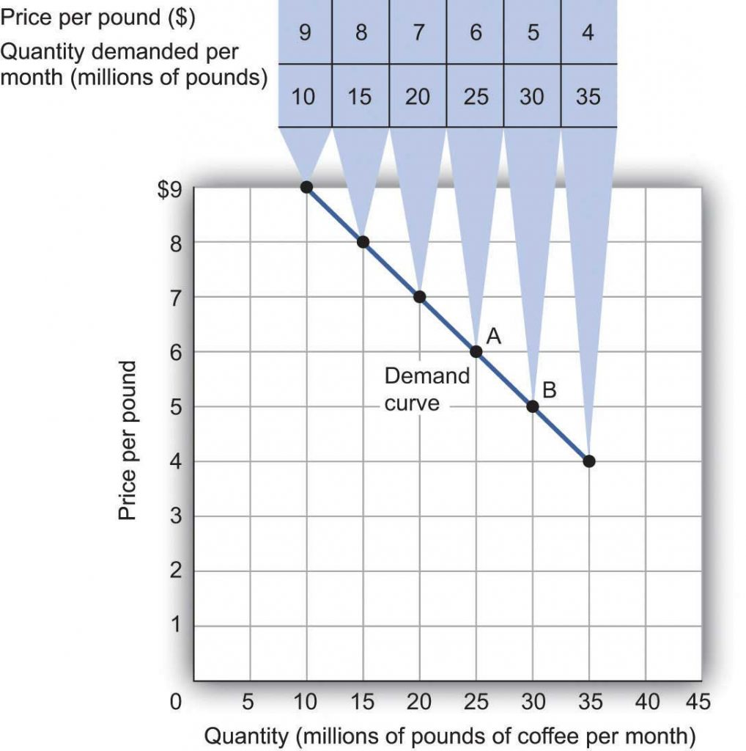
3.1 Demand Example Continued
The information given in a demand schedule can be presented with a demand curve, which is a graphical representation of a demand schedule.
A demand curve thus shows the relationship between the price and quantity demanded of a good or service during a particular period, all other things unchanged. The movement from point A to point B as the price falls is called change in quantity demanded.
Fig 3.1
Notes:
The demand curve in the above figure shows the prices and quantities of coffee demanded that are given in the demand schedule. At point A, for example, we see that 25 million pounds of coffee per month are demanded at a price of $6 per pound. By convention, economists graph price on the vertical axis and quantity on the horizontal axis.
A change in price, with no change in any of the other variables that affect demand, results in a movement along the demand curve. If the price of coffee falls from $6 to $5 per pound, consumption rises from 25 million pounds to 30 million pounds per month. That is a movement from point A to point B along the demand curve in Fig 3.1. A movement along a demand curve that results from a change in price is called a change in quantity demanded. Note that a change in quantity demanded is not a change or shift in the demand curve; it is a movement along the demand curve.
All other things unchanged, the Law of demand holds that, for virtually all goods and services, a higher price leads to a reduction in quantity demanded and a lower price leads to an increase in quantity demanded. The law of demand is called a law because the results of countless studies are consistent with it. Given the values of other variables that influence demand, a higher price reduces the quantity demanded. A lower price increases the quantity demanded. Demand curves, in short, slope downward, as seen in the graph above.

Slide 7
3.2 Changes in Demand
Factors that change demand:
Prices of Related Goods and Services
Income
Preferences
Demographic Characteristics
Buyer Expectations about future prices
Notes:
An alternative to coffee is tea, so a reduction in the price of tea might result in the consumption of more tea and less coffee. Thus, a change in any one of the variables held constant in constructing a demand schedule will change the quantities demanded at each price. The result will be a shift in the entire demand curve rather than a movement along the demand curve. A shift in a demand curve is called a change in demand.
Price alone does not determine the quantity of a good or service that people consume.
Coffee consumption, for example, will be affected by such variables as income and population. Preferences also play a role. We also expect other prices to affect coffee consumption. People often eat doughnuts or bagels with their coffee, so a reduction in the price of doughnuts or bagels might induce people to drink more coffee.

Slide 8
3.2 Prices of Related Goods and Services
If a reduction in the price of one good increases the demand for another, the two goods are called complements
If a reduction in the price of one good reduces the demand for another, the two goods are called substitutes.
These definitions hold in reverse as well: two goods are complements if an increase in the price of one reduces the demand for the other, and they are substitutes if an increase in the price of one increases the demand for the other.

Slide 9
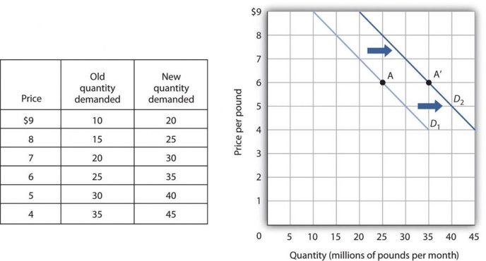
3.2 Prices of Related Goods and Services
A change in quantity demanded refers to movement along the demand curve while a change in demand is referred to a shift.
A rightward shift of the demand curve is called an increase in demand.
Fig 3.2
Notes:
Refer to Fig 3.2, when the price of tea, a substitute for coffee rises, more coffee is demanded at each price, as people substitute away from tea and consume more coffee. The result is a shift in demand from the original curve D1 to D2. The quantity of coffee demanded at a price of $6 per pound rises from 25 million pounds per month (point A) to 35 million pounds per month (point A′). Note, that a change in quantity demanded, ceteris paribus, refers to a movement along the demand curve, while a change in demand refers to a shift in the demand curve. A rightward shift of the demand curve is called an increase in demand.

Slide 10
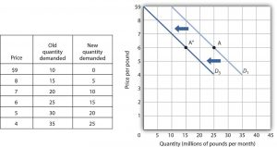
3.2 Change in Demand
A leftward shift of the demand curve is called a decrease in demand.
Fig 3.3
Notes:
Refer to Fig 3.3, when the price of tea, a substitute for coffee falls, less coffee is demanded at each price, as people substitute away from coffee because tea is relatively cheaper. The result is a shift in demand from the original curve D1 to D3. The quantity of coffee demanded at a price of $6 per pound falls from 25 million pounds per month (point A) to 15 million pounds per month (point A″).

Slide 11

3.2 Income
As incomes rise, people increase their consumption and as incomes fall, their consumption falls.
A good for which demand increases when income increases is called a normal good.
A good for which demand decreases when income increases is called an inferior good.
Photo by Sharon McCutcheon on is licensed under the Unsplit License
Notes:
As incomes rise, for example, people tend to consume more fresh fruit but less canned fruit. A good for which demand increases when income increases is called a normal good. A good for which demand decreases when income increases is called an inferior good. An increase in income shifts the demand curve for fresh fruit (a normal good) to the right; it shifts the demand curve for canned fruit (an inferior good) to the left.

Slide 12
3.2 Preferences
Changes in preferences of buyers can have important consequences for demand. An example is reduced demand for cigarettes caused by concern about the effect of smoking on health. A change in preferences that makes one good or service more popular will shift the demand curve to the right. A change that makes it less popular will shift the demand curve to the left.

Slide 13
3.2 Demographic Characteristics
The number of buyers affects the total quantity of a good or service that will be bought; in general, the greater the population, the greater the demand.
Population over age 65 increases, the demand for medical services increases.
When birth rates increase, this raises the demand for such things as infant supplies, elementary school teachers, soccer coaches, in-line skates, and college education.

Slide 14
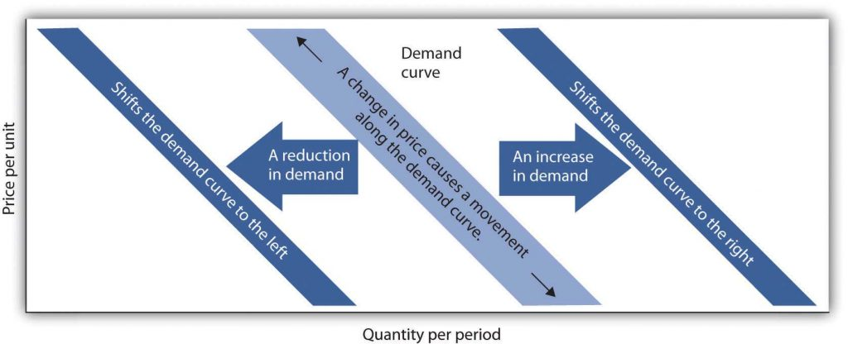
3.2 Buyer Expectations About Future Prices
Fig 3.4
Notes:
The consumption of goods that can be easily stored, or whose consumption can be postponed, is strongly affected by buyer expectations. The expectation of newer TV technologies, such as high-definition TV, could slow down sales of regular TVs. If people expect gasoline prices to rise tomorrow, they will fill up their tanks today to try to beat the price increase. The same will be true for goods such as automobiles and washing machines: an expectation of higher prices in the future will lead to more purchases today. If the price of a good is expected to fall, however, people are likely to reduce their purchases today and await tomorrow’s lower prices. The expectation that computer prices will fall, for example, can reduce current demand.

Slide 15
3.3 Quantity Supplied
The quantity supplied of a good or service is the quantity sellers are willing to sell at a particular price during a particular period, all other things unchanged.
Ceteris paribus, the receipt of a higher price increases profits and induces sellers to increase the quantity they supply.
An increase in price results in an increase in quantity supplied, and this relationship is often referred to as the Law of supply, other factors remaining unchanged.

Slide 16
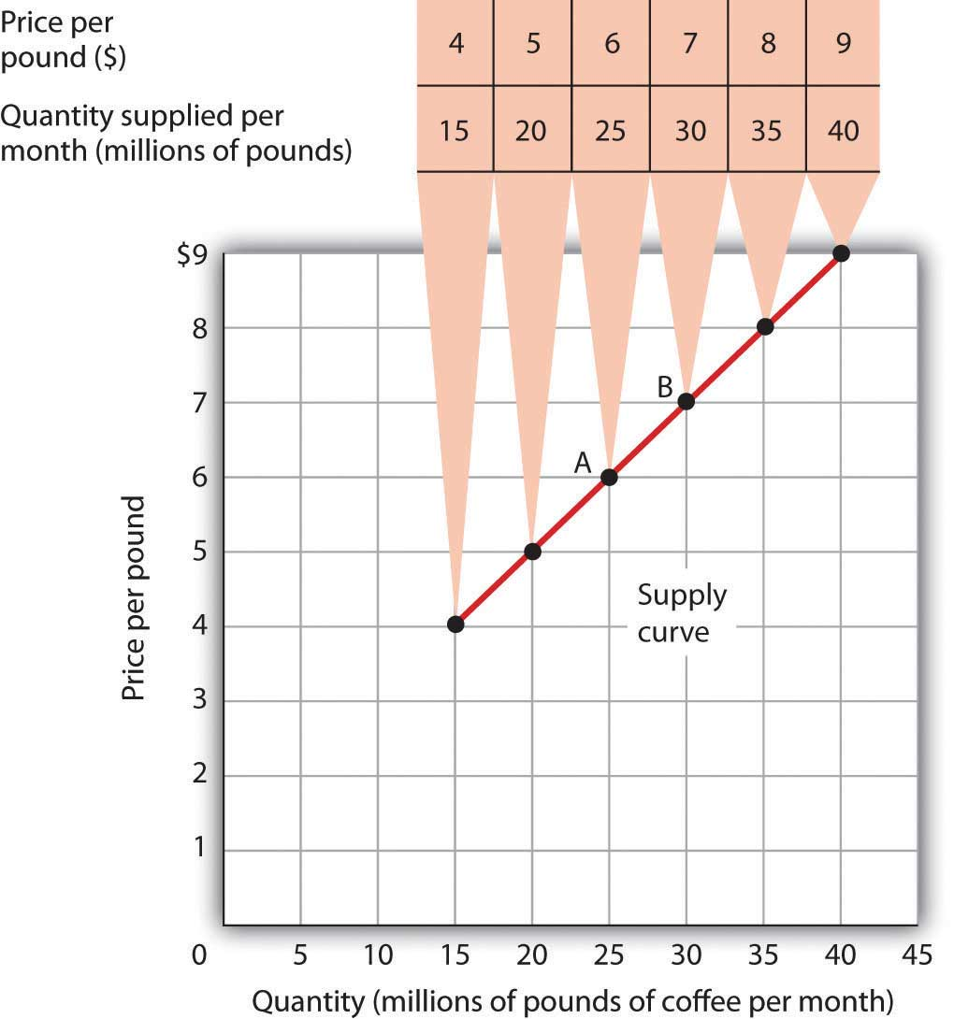
3.3 Change in the Quantity Supplied

Slide 17
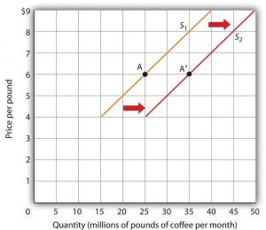
3.3 Increase in Supply
Price | Old Quantity Supplied | New Quantity Supplied
$4 | 15 | 25
$5 | 20 | 30
$6 | 25 | 35
$7 | 30 | 40
$8 | 35 | 45
$9 | 40 | 50
Fig 3.5
Fig 3.6
Notes:
The information given in a supply schedule in Fig 3.5 can be presented with a supply curve, which is a graphical representation of a supply schedule, as shown in Fig 3.6. A supply curve thus shows the relationship between the price and quantity supplied of a good or service during a particular period, all other things unchanged. Because the relationship between price and quantity supplied is generally positive, supply curves are generally upward sloping.
A change in price causes a movement along the supply curve; such a movement is called a change in quantity supplied. As is the case with a change in quantity demanded, a change in quantity supplied does not shift the supply curve. By definition, it is a movement along the supply curve. For example, if the price rises from $6 per pound to $7 per pound, the quantity supplied rises from 25 million pounds per month to 30 million pounds per month. That’s a movement from point A to point B along the supply curve in Fig 3.6.

Slide 18
3.4 Changes in Supply
When we draw a supply curve, we assume that other variables that affect the willingness of sellers to supply a good or service are unchanged. It follows that a change in any of those variables will cause a change in supply, which is a shift in the supply curve.
Suppose the cost of producing coffee decreases due to a drop in the price of coffee beans. This increases the quantity of coffee supplied at each price and the result is a shift in the supply curve to the right. This shift in the supply curve is called a change in supply.

Slide 19

3.4 Factors That Change Supply
Prices of Factors of Production
Prices of related goods
Seller expectations about future prices
Number of producers
Technology
Natural events
Photo by carlos aranda, is licensed under the Unsplit License

Slide 20
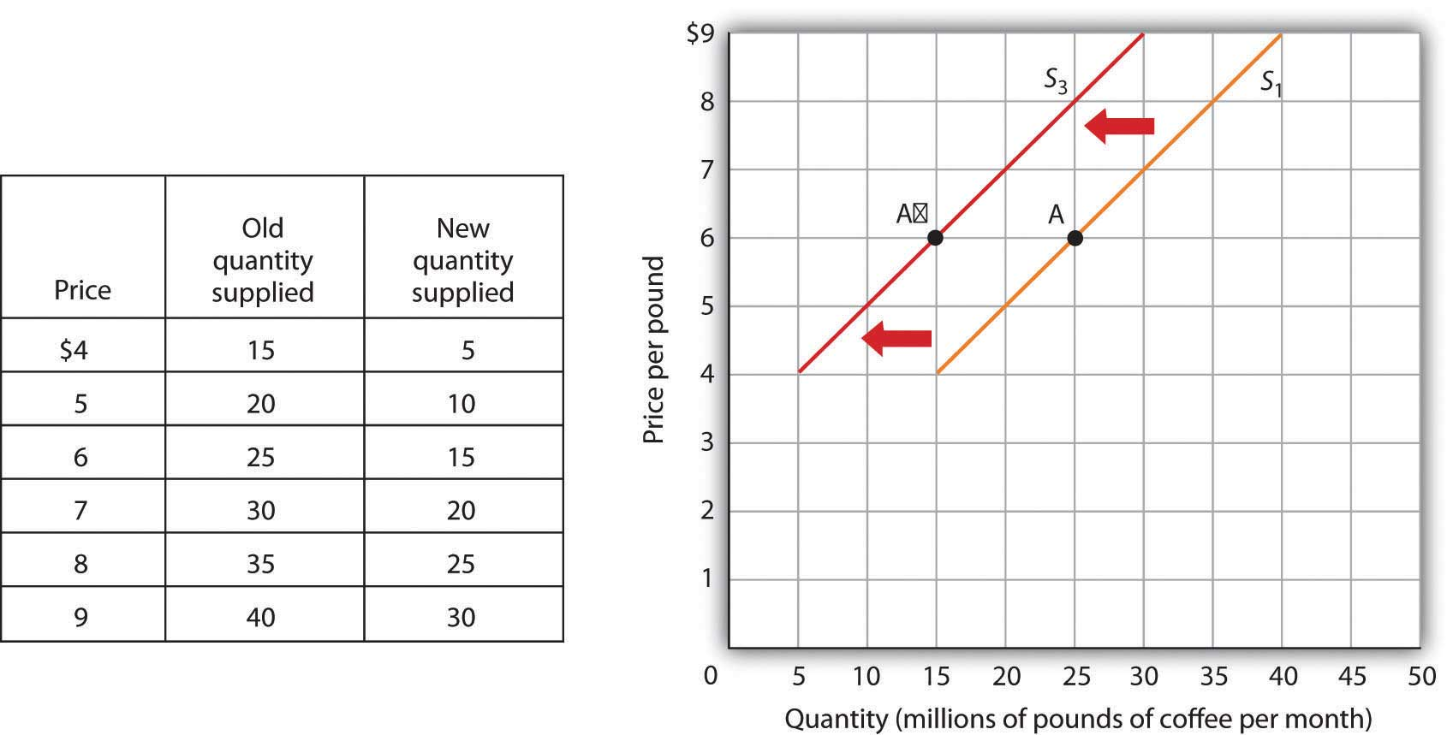
3.4 Prices of Factors of Production – Reduction in Supply
Fig 3.8
Notes:
An event that reduces the quantity supplied at each price shifts the supply curve to the left. Adverse weather such as excessive rain that reduces the yields from coffee plants are examples of events that might reduce supply. Fig 3.8 shows a reduction in the supply of coffee. We see in the supply schedule that the quantity of coffee supplied falls by 10 million pounds of coffee per month at each price. The supply curve thus shifts from S1 to S3.

Slide 21

3.4 Prices of Related Goods
Like demand, there could be substitutes in production as well.
Suppose, a producer makes cupcakes and cookies. If the relative price of cupcakes rises, the producer tends to devote more time and resources to producing cupcakes, because that is more profitable, so the number of cupcakes supplied increases.
Photo by Lana Mattice, licensed under the Unsplit License
Notes:
At the same time, the opportunity cost of producing cupcakes increases. The opportunity cost of producing a cupcake is not producing cookies. So, the supply of cookies decreases, and the supply curve of cookies shifts leftward due to a rise in the price of a related (substitute) good.

Slide 22
3.4 Seller Expectations About Future Prices
Like demand, expectations of the supply price affect production decisions.
Production decisions are based on the current knowledge we have about those prices. Expectations are based on evidence or a signal.
If you have reason to believe the prices of cupcakes will drastically rise from next week, you may devote less of your attention to producing them today and increase the quantity supplied next week when the price rises.
If the firm expects future prices to rise, supply will decrease today. If the firm expects future prices to fall, supply will increase in the current period.
Notes:
Normally, you will be confident that these prices will stay relatively stable, but if you have reason to believe the prices of cupcakes will drastically rise from next week, you may devote less of your attention to producing them today and increase the quantity supplied next week when the price rises. Expectations are usually based on some form of evidence or signal and can cause supply shifts quite suddenly. If the firm expects future prices to rise, supply will decrease today. If the firm expects future prices to fall, supply will increase in the current period.

Slide 23
3.4 Number of Producers
An increase in the number of sellers supplying a good or service shifts the supply curve to the right; a reduction in the number of sellers shifts the supply curve to the left.
If for example, four new coffee-producing stores enter the market, more will be supplied at each price.
Notes:
The market for cellular phone service has been affected by an increase in the number of firms offering the service. Over the past decade, new cellular phone companies emerged, shifting the supply curve for cellular phone service to the right.

Slide 24
3.4 Technology
A change in technology alters the combinations of inputs or the types of inputs required in the production process.
An improvement in technology usually means that the same amount of input can now produce more due to increased productivity from the advanced technology.
Notes:
With more produced at every price, the supply curve will shift to the right, meaning an increase in supply.
Impressive technological changes have occurred in the computer industry in recent years. Computers are much smaller and are far more powerful than they were only a few years ago due to innovation. The result has been a huge increase in the supply of computers, shifting the supply curve to the right.

Slide 25
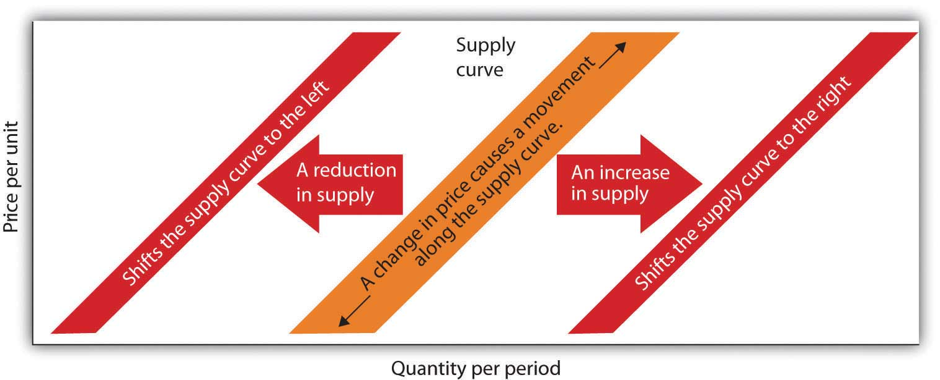
3.4 Natural Events
Notes:
Storms, insect infestations, and drought affect agricultural production and thus the supply of agricultural goods. If something destroys a substantial part of an agricultural crop, the supply curve will shift to the left. The terrible cyclone that killed more than 50,000 people in Myanmar in 2008 also destroyed some of the country’s prime rice-growing land. That shifted the supply curve for rice to the left. If there is an unusually good harvest, the supply curve will shift to the right.

Slide 26
3.5 Demand, Supply and Equilibrium
The logic of the model of demand and supply is simple.
The demand curve shows the quantities of a particular good or service that buyers will be willing and able to purchase at each price during a specified period.
The supply curve shows the quantities that sellers will offer for sale at each price during that same period.

Slide 27
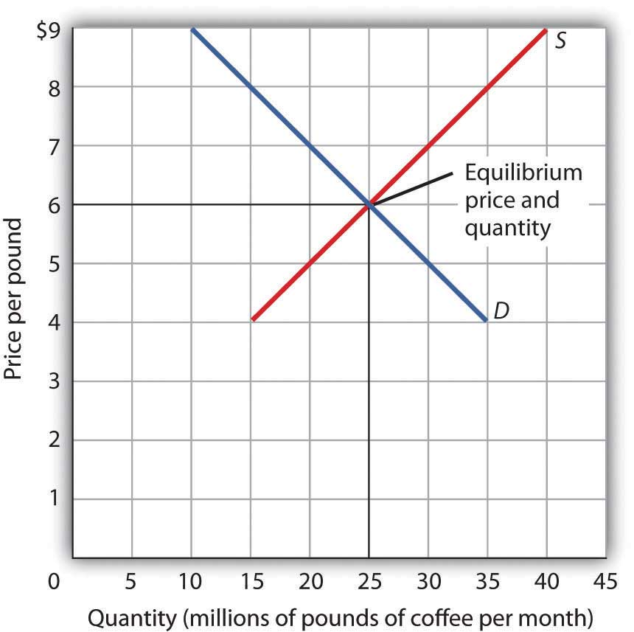
3.5 Market Equilibrium
The two curves intersect at a price of $6 per pound—at this price the quantities demanded and supplied are equal.
Buyers want to purchase, and sellers are willing to offer for sale, 25 million pounds of coffee per month.

Slide 28
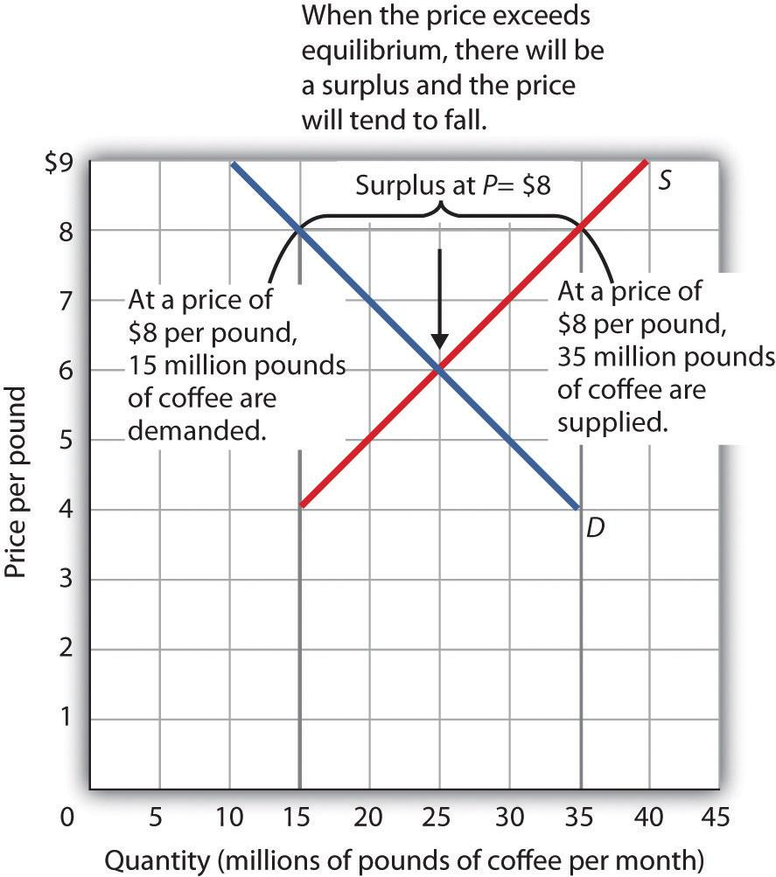
3.5 Surplus
A surplus is the amount by which the quality supplied exceeds the quantity demanded at the current price. A surplus occurs only if the current price exceeds the equilibrium price.
Notes:
Fig 3.11 shows the same demand and supply curves we have just examined, but this time the initial price is $8 per pound of coffee. Because we no longer have a balance between quantity demanded and quantity supplied, this price is not the equilibrium price. At a price of $8, the quantity of coffee consumers will be willing to buy—15 million pounds per month. The supply curve tells us what sellers will offer for sale—35 million pounds per month. The difference, 20 million pounds of coffee per month, is called a surplus.
A surplus in the market for coffee will not last long. With unsold coffee on the market, sellers will begin to reduce their prices to clear out unsold coffee. As the price of coffee begins to fall, the quantity of coffee supplied begins to decline. At the same time, the quantity of coffee demanded begins to rise. Remember that the reduction in quantity supplied is a movement along the supply curve—the curve itself does not shift in response to a reduction in price.

Slide 29
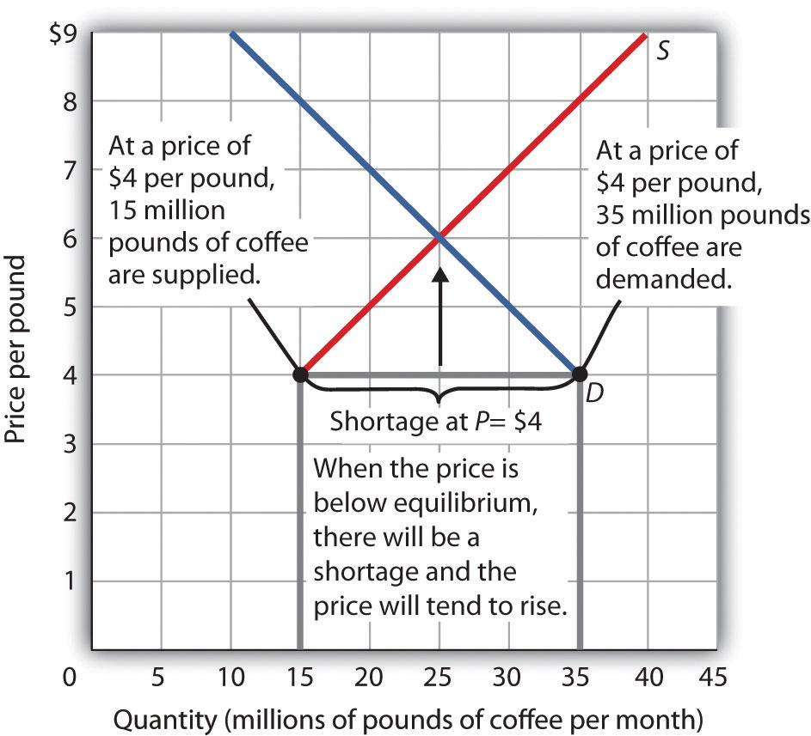
3.5 Shortage
A shortage is the amount by which the quantity demanded exceeds the quantity supplied at the current price.
Notes:
Fig 3.12 shows a shortage in the market for coffee. Suppose the price is $4 per pound. At that price, 15 million pounds of coffee would be supplied per month, and 35 million pounds would be demanded per month. When the quantity demanded exceeds the quantity supplied, there is a shortage. In the face of a shortage, sellers are likely to begin to raise their prices. As the price rises, there will be an increase in the quantity supplied (but not a change in supply) and a reduction in the quantity demanded (but not a change in demand) until the equilibrium price is achieved.

Slide 30
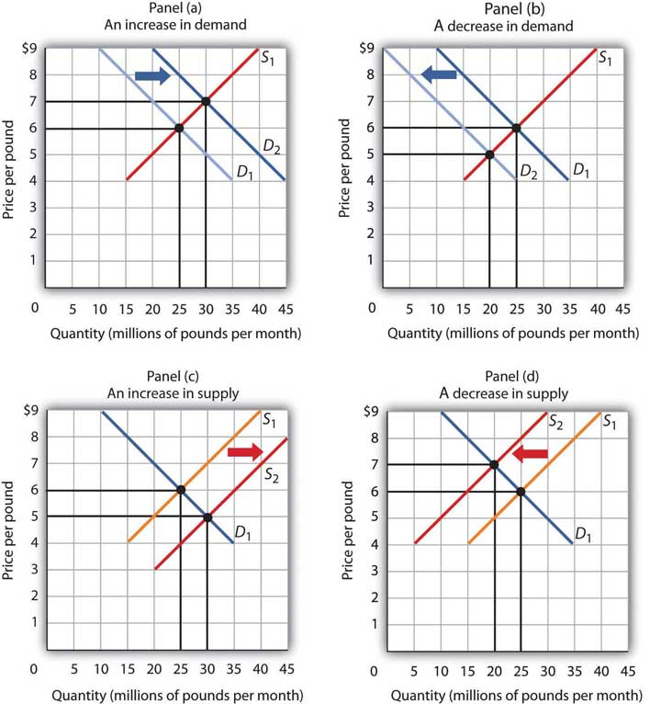
3.6 Shifts in Demand and Supply
Notes:
The above graphs show the market for coffee. Refer to Panel A, suppose the original equilibrium price and quantity of coffee are $6 and 25 pounds respectively. Now assuming Coffee is a normal good, an increase in income, with no change in the price of coffee and/or other factors, will increase the demand for coffee and shift the demand curve to the right.
The equilibrium price of coffee rises to $7 and the equilibrium quantity increases to 30 pounds. Panel B shows the decrease in the demand for coffee when income decreases and the demand curve shifting to the left. The equilibrium price of coffee falls and the equilibrium quantity decreases.
Refer to Panel C, suppose the initial equilibrium price and quantity of coffee are $6 and 25 pounds respectively. If the cost of producing coffee decreases, ceteris paribus, the supply of coffee increases and shifts the supply curve to the right resulting in a fall in the equilibrium price of coffee to $5 and an increase in the equilibrium quantity to 30 pounds.
Panel D shows the decrease in the supply of coffee when the production cost increases and the supply curve shifting to the left. The equilibrium price of coffee rises and the equilibrium quantity decreases.

Slide 31
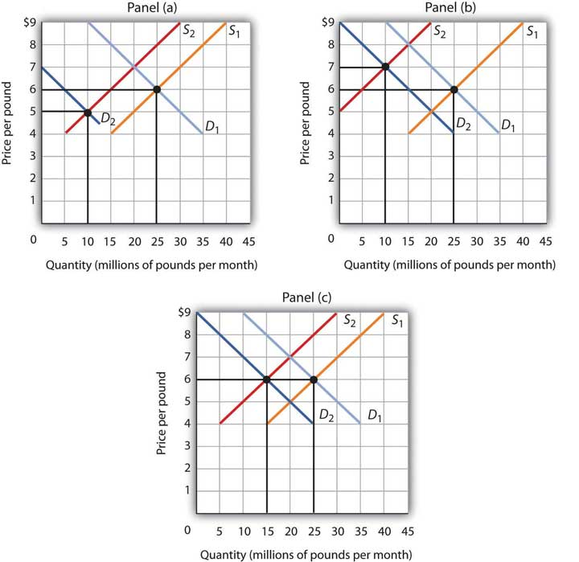
3.6 Simultaneous shifts in Demand and Supply
Notes:
As we have seen, when either the demand or the supply curve shifts, the results are unambiguous; that is, we know what will happen to both equilibrium price and equilibrium quantity, so long as we know whether demand or supply increased or decreased.
However, in practice, several events may occur at around the same time that causes both the demand and supply curves to shift. To figure out what happens to equilibrium price and equilibrium quantity, we must know not only in which direction the demand and supply curves have shifted but also the relative amount by which each curve shifts. Of course, the demand and supply curves could shift in the same direction or in opposite directions, depending on the specific events causing them to shift.

Slide 32
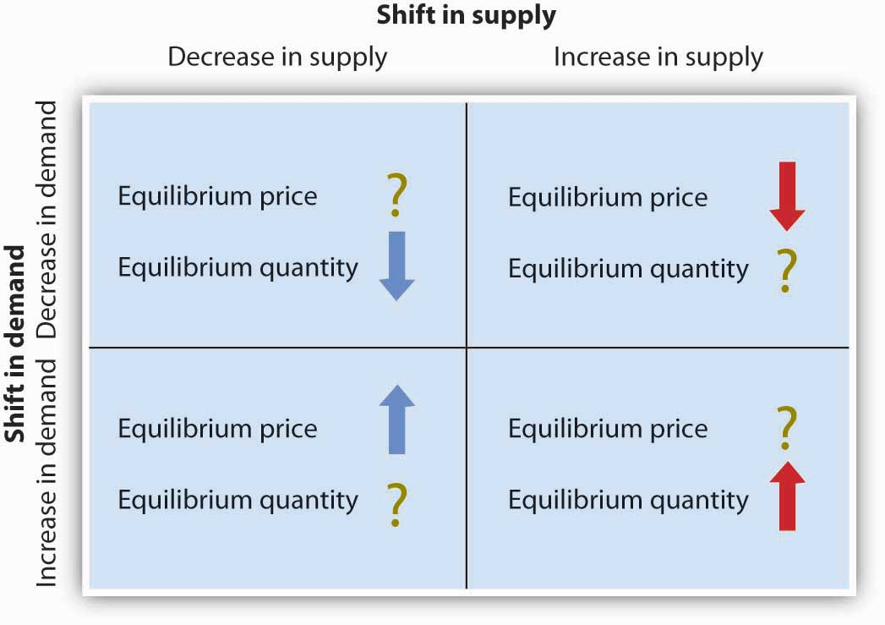
3.6 Shifts in Demand and Supply con’t
Notes:
All three panels of Fig 3.14 show a decrease in demand for coffee (caused perhaps by a decrease in the price of a substitute good, such as tea) and a simultaneous decrease in the supply of coffee (caused perhaps by bad weather).
Since reductions in demand and supply, considered separately, each cause the equilibrium quantity to fall, the impact of both curves shifting simultaneously to the left means that the new equilibrium quantity of coffee is less than the old equilibrium quantity. The effect on the equilibrium price, though, is ambiguous. Whether the equilibrium price is higher, lower, or unchanged depends on the extent to which each curve shifts.
If the demand curve shifts farther to the left than does the supply curve, as shown in Panel A of Fig 3.14, then the equilibrium price will be lower than it was before the curves shifted. In this case, the new equilibrium price falls from $6 per pound to $5 per pound.
If the shift to the left of the supply curve is greater than that of the demand curve, the equilibrium price will be higher than it was before, as shown in Panel B. In this case, the new equilibrium price rises to $7 per pound. In Panel C, since both curves shift to the left by the same amount, the equilibrium price does not change; it remains $6 per pound.
Regardless of the scenario, changes in equilibrium price and equilibrium quantity resulting from two different events need to be considered separately. If both events cause equilibrium price or quantity to move in the same direction, then clearly price or quantity can be expected to move in that direction.

Slide 33
3.7 Summary: Demand Shocks
Demand Shock | Increase in Demand, Shifts curve to the Right | Decrease in Demand, Shifts curve to the Left
Price of a Substitute | Increases | Decreases
Price of Factors of Production | Decreases | Increases
Buyers’ Expectations about Future Prices | Increases (Normal Good) | Decreases (Normal Good)
Preferences | Increases | Decreases
Demographic Characteristics (Population) | Increases | Decreases
Buyers’ Expectations about Future Prices | Increases | Decreases

Slide 34
3.7 Summary: Supply Shocks
Supply Shock | Increase in Supply, Shifts curve to the Right | Decrease in Supply, Shifts curve to the Left
Price of factors of production | Decreases | Increases
Price of a Substitute | Decreases | Increases
Sellers’ Expectations about Future Prices | Decreases | Increases
Number of Producers | Increases | Decreases

Slide 35
3.8 Key Terms
Change in Quantity Demanded
Change in Demand
Movement Along The Supply Curve
Change in Quantity Supplied
Change in Supply
Substitutes
Complements
Normal Goods
Inferior Goods
Shortage
Surplus

